Slide 1
Ministry of ICT and National Guidance Implementation of the Manifesto Commitments and Strategic Guidelines and Directives (2016-2021) By Hon Nabakooba Nalule Judith (MP) Minister for ICT & National Guidance Manifesto Week May 11th 2021

Slide 2
OUTLINE
Background
ICT Usage Statistics
MoICT&NG Sector Contribution to NDP III
MoICT&NG Sector Performance
Cross-cutting issues
Challenges
Targets that were partially met
Conclusion

Slide 3
Introduction
The ICT&NG Sector is composed of
Ministry of ICT & National Guidance;
National Information Technology Authority- Uganda;
Uganda Communications Commission;
Uganda Post Limited;
Uganda Institute of Information and Communications Technology;
Uganda Broadcasting Corporation;
Uganda Media Centre and
The Media Council

Slide 4
Introduction
Sector Mission:
To increase access and usage of ICT infrastructure and services throughout the country, ensure effective communication of government policies and programmes and promotion of a national ideology for socio economic transformation.
The Sector Outcomes:
a) Responsive ICT legal and regulatory environment;
b) Secure ICT access and usage for all;
c) Increased employment and growth opportunities and
d) Increased Awareness and Citizen Participation in Government programs

Slide 5
Introduction
ICT adoption is critical in improving service delivery for citizens and businesses, and to foster more productive, competitive economy and inclusive growth;
ICT services in Uganda continued to grow at an impressive average growth rate of 14.8 percent during the period (2014/15 to 2019/20);
ICT grew by 21.9 percent in 2019/20, contributing 3.5 percent to total services added to the economy
As of December 2020, the telecom sector contribution to tax revenue hit 1.1 trillion, up from 131bn in 2016

Slide 6
ICT USAGE STATISTICS
Mobile Subscriptions
Internet Subscription
13
From 8.04M in 2016
Public Service Providers
From 22.37M in 2016
to 21.4M in 2020
to 27.78M in 2020
Public Infrastructure Providers
25
Mobile Money Subscription
Number of Radio Stations
Tele-density (%)
From 19.63M in 2016
From 61.2% in 2016
to 22.52M in 2020
330 in 2020
to 67% in 2020
Mobile Money Agents
No of Pay TV Service Providers
From 119,581 in 2016
Internet Penetration (%)
to 235,790 in 2020
From 25.03% in 2016
From 7 in 2016
National Telecom Operators
to 52% in 2020
to 8 in 2020
3
Population Coverage
No of Operational TV Stations (local)
Active Pay TV Subscriptions
3G- 74%, 4G- 64%
From 17 in 2016
From 777,588 in 2016
to 40 in 2020
to 1,616,66 in 2020

Slide 7
MoICT&NG Sector Contribution to NDP III
The Sector will contribute to 2 NDP III Programmes below;
Digital Transformation Programme (Programme 10)
Community Mobilisation and Mindset Change (Programme 14)
Digital Transformation aims to increase ICT penetration and use of ICT services for social and economic development.
The expected results are to: increase ICT penetration; reduce cost of ICT devices and services; create more direct jobs in the sector; and increase government services online.

Slide 8
MoICT&NG Sector Contribution to NDP III
Community Mobilisation and Mindset Change (Programme 14) aims to empower families, communities and citizens to embrace national values and actively participate in sustainable development.
Key results include:
increased participation of families, communities and citizens in development initiatives;
enhanced media coverage of national programmes; and
better uptake and/or utilisation of public services (education, health, child protection etc.) at the community and district level.

Slide 9
Legal and Regulatory Environment

Slide 10
Laws & Regulations
Data Protection and Privacy Act 2019
Data Protection and Privacy Regulation 2021
17 Uganda Communications Regulations (2019)
NITA-U (Certification of Providers of IT Products & Services) Regulation 2016 as amended
NITA-U (National Databank) Regulations 2019
New License Framework for Telecommunication and Broadcasting Industries
Media Guidelines for the General Elections
Broadcasting Standards developed include:
Broadcast Content Standards
Standards for Religious Broadcast Programming,
Standards for General Broadcast Programming
Advertising Standards
Standards for the provision of live coverage

Slide 11
Policies and Strategies
Digital Uganda Vision
National Broadband Policy 2018
National Strategy on the Fourth Industrial Revolution (4IR)
The Artificial Intelligence Strategy Blueprint
Development of National Digital Transformation Policy (ongoing)
Review of National Cyber Security Strategy (ongoing)
Development of E-Government Interoperability Framework and Enterprise Architecture (ongoing)
Development of a strategy to enhance and sustain the ICT function in the government of Uganda (ongoing)
Development of National guidance policy (ongoing)

Slide 12
Studies
Feasibility Study on Electronics Assembly and Manufacturing conducted for the development of a supportive enabling environment for electronics manufacturing;
Gap Analysis of the ICT Legal frameworks policies, standards and regulations
National IT Survey 2018 conducted to inform policy
National eCommerce Readiness Assessment conducted
National Broadband Survey and Infrastructure Blueprint (ongoing)
Baseline Survey of Waste from Electronic Equipment (ongoing)
ICT Skills Training Needs Assessment and Training Action Plan (Ongoing)

Slide 13
Digital Infrastructure and Connectivity

Slide 14
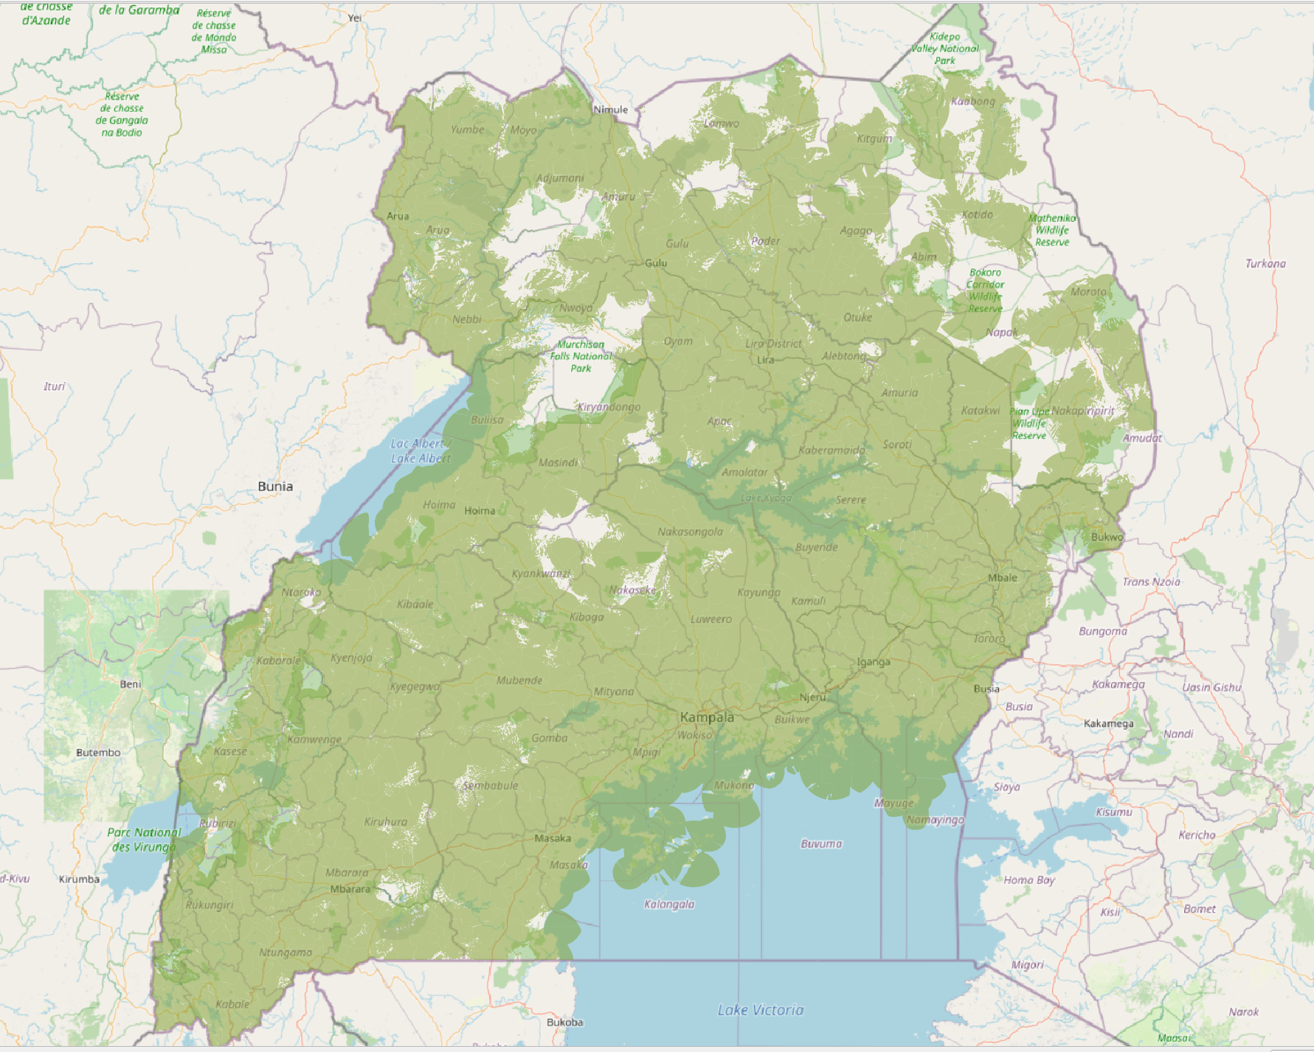
ACCESS TO ICTS- Voice Coverage
Coverage
Mobile Cellular Voice Coverage is near national
Mobile Cellular Geographic signal coverage stands at 80% of the country.
This translates into population coverage of 72% for basic voice

Slide 15
ACCESS TO ICTS- Broadband Coverage
Geographical coverage of broad band services (3G) stands at 66% which translates to 74% population coverage.
25 broadband sites upgraded from 2G to 3G providing broadband services to over 700,000 Ugandans
Implemented free wifi-hotspots at nine (09) border posts i.e. Lwakhaka, Mpondwe, Mutukula, Busia, Bunagana, Vurra, Katuna, Malaba and Elegu.

Slide 16
ICT Infrastructure Development
Achievements:
A total of about 4000km of Fiber Optic cable laid;
1,026 MDAs and LGs sites connected to NBI.
31 Police stations and 9 UPDF sites connected to the NBI
NBI extended to Pakwach, Nebbi, Arua, Koboko, Yumbe, Moyo, Adjumani, Katakwi and Moroto
Border posts of Mpondwe, Vurra, Oraba, Elegu/Nimule connected to the NBI.
The alternative routes to the sea cables completed through Mutukula, Katuna, Busia, Malaba

Slide 17
ICT Infrastructure Development
A state-of-the art Tier III National Data Centre and a Disaster Recovery Site established;
Data Centre currently provide services to 85 Government Institutions, hosting 165 applications and 358 web services
Free Wi-Fi (‘MyUg’) is provided to the general public in 284 locations in the Central Business District of Kampala and Entebbe.
There are over 2 million users on the MYUG platform each month.

Slide 18
Prices of Internet Services
76% reduction in the cost of Internet for Government from 300$ to 70$ per Mbps month, expected to drop to 50$ next FY.

Slide 19
ICT Infrastructure Development
22 base stations in rural areas upgraded from 2G to 3G to provide internet to over 1,000,000 Ugandans;
Tests for internet connectivity using VSAT technology conducted in tourist sites of Bwindi and Kidepo Valley National Parks
Validation of SIM Card Registration with National ID details was done;

Slide 20
Digital Services

Slide 21
Key Performance highlights
Uganda's online service index has improved from 50 percent in 2016 to 58.24% in 2020, putting the country in the high online service index bracket of the United Nations
There are currently 330 National ICT systems and databases in government, up from 47 in 2015.
71% of government services are offered electronically via institutional websites, email, Social media, SMS and Mobile applications.

Slide 22
Key Performance highlights
106 e-services can be accessed through the e-services portal www.ecitizen.go.ug
The Sector has also embarked on integration of government systems that have not been communicating with each other. 12 MDAs are in pilot phase
700 laptops provided to MDAs towards adoption of eServices

Slide 23
Key Performance highlights
Unified Messaging and Collaboration system
Rolled out to additional 29 MDAs bringing the total to 65 MDAs. So far 15,428 users have been enrolled across Government and 17,090 licenses had been distributed
Rollout the e-Payment Gateway
8 e-services integrated with e-payment system from (KCCA, MOGLSD, NITA-U,NBRB)
6 Banks (UBA, NC, GT, Orient, Centenary, Equity) using the gateway
MTN & Airtel Integrated

Slide 24
Key performance highlights ctn.
Development and rollout of the e-Government Procurement system
e-Government Procurement System was launched
System rolled out in 7 Pilots
User Training on the system conducted
Rollout of the SMS Gateway
SMS Gateway rolled out in additional 6 entities bringing the total number to 20 entities using the service & 11,530,614 SMSs have been pushed out from the gateway

Slide 25
Key Performance highlights
Roll-out of the Integrated Health Management System (iHMIS) was transferred to MoICT&NG by the Rt Hon Prime Minister
The postal domestic mail management system and mail processes digitized through the E-Post platform

Slide 26
ICT-Based Community Centres
Public Access Points installed at 12 Post Offices in partnership with Uganda Posts Limited
Public Access points established in 10 Public Libraries countrywide in partnership with National Libraries of Uganda
17 Public Access Centres established in the several areas including; Lugazi, Mubende, Wakiso, Kiruhura, Kampala, Lwengo, Ntungamo, Wakiso and Lyantonde.
Supported Ministry of Public Service in the establishment of eService Centres around the country e.g. Kasese and Jinja

Slide 27
Innovation and Entrepreneurship

Slide 28
ICT Innovation
Government is promoting ICT innovation to create jobs, for import substitution and to avoid over dependence on foreign ICT products;
A National ICT Innovation Hub for 500 innovators has been constructed in Nakawa;
Innovation grants have been given to 132 Innovators and to 6 private sector Innovation Hubs under the National ICT Initiatives Support Programme (NIISP);
Locally developed eGovernment systems include eProcurement system, the Parish Model Management Information System, the Government Asset Management System, Education Management Information System, Electronic Document Management System, Integrated Health Management Information System and the ePost Digital Platform. ,
National ICT Innovation Hub - Nakawa

Slide 29
ICT Innovation
The Ministry is currently working with Muni, Gulu and Soroti Universities to set up regional ICT Innovation Hubs
Partnerships have been made with academia like Makerere University and Wits University
The Ministry has partnerships with all the local private innovation hubs

Slide 30
Development of ICT Parks
Land for IT/BPO Park provided by HE the President in Entebbe to facilitate job creation and innovation.
Feasibility study has been completed and transaction advisor procured.
Design completed and market sounding exercise undertaken
PPP proposal submitted to Privatisation Unit for approval

Slide 31
Business Process Outsourcing (BPO)
Subsidised internet bandwidth is being provided to 5 BPO/innovation companies i.e. Cameo Tech, Technobrain, Munu Tech, BDE consults and Cayman Consults
GoU BPO Center at Statistics House and private BPO centres are providing employment to the youth

Slide 32
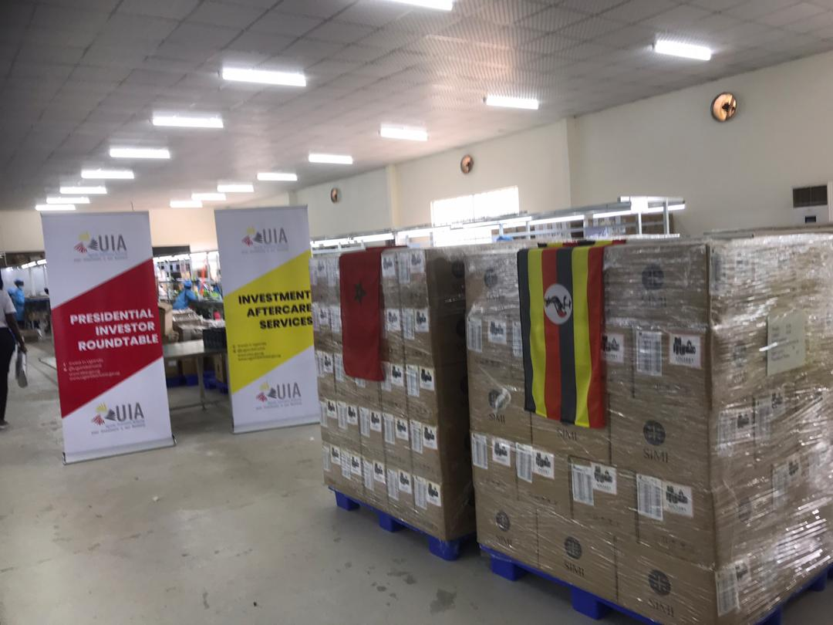
Manufacturing of Electronics
In 2016, HE the President directed the Ministry of ICT&NG to promote assembling and manufacturing of electronics in Uganda;
In August 2018, Satchi TV Assembly Plant was commissioned by HE in Ntinda;
In November 2019, Mobile Phone and Computer manufacturing by Simi Mobile was launched by HE in Namanve;
The company shipped the first consignment of 18,000 mobile phones assembled in UG to Morocco in 2020

Slide 33
Digital Skills

Slide 34
Human Capital Development
MoICT&NG was made the parent home for ICT and Communication Officers by Cabinet
Over 1,150 School ICT labs equipped under RCDF;
Over 3,000 teachers and school heads have been retooled in partnership with MoES
Over 10,000 SMEs trained in use of ICTs for business as part of the Digital Literacy Programme.
Over 80 Sensitization sessions on cyber laws and cyber security conducted

Slide 35
Human Capital Development
Uganda Institute of ICT Master Plan developed and Institute infrastructure refurbished
5 specialized labs at UICT refurbished and equipped (i.e. Electronics Lab, Telecom Lab, Electrical Lab, Multimedia Lab, VUE Professional Testing and Certification Centre, Computer Laboratories (02) including the Server Room);
UICT achieved the following:
Trained and graduated over 2,431 students in ICT skills specialties;
Trained and certified 1,037 SMEs in Citizenship Digital Literacy Skills ((market vendors, juwakali, tailors)
Certified 1,670 Professionals in specialized short courses in ICT and management such as CCNA, Fiber optics, Electronics and ITU courses
Trained 1,249 participants the Covid-19 Workforce Recovery Initiative Programme
Trained 764 participants from 95 Districts in ICT Digital Literacy using eLearning

Slide 36
Human Capital Development
High speed internet connectivity extended to 382 school laboratories
Science content software deployed in 500 schools and annual licenses maintained
Phase I of the E-learning pilot project completed covering four secondary schools.

Slide 37
Usage of ICTs by special Interest Groups
ICTs for PWDs
Completed training of 30 groups of PWDs in partnership with National Union of Women with Disabilities of Uganda (NOWOUDU)
Specialized ICT equipment for Persons with Special Needs deployed at Gulu High School for the Blind and Mbale School for the Deaf

Slide 38
Cyber Security & Data Privacy

Slide 39
Performance
Uganda is currently ranked 7th in Africa in Cyber Security;
National Computer Emergency Response Centre (CERT) and Communications CERT established;
MDAs supported to enhance their cyber security readiness;
Technical assistance provided in the handling of cyber security incidents;
Cyber security training and awareness conducted;
Cyber security advisory services and alerts provided.

Slide 40
Community Mobilisation and Mindset Change

Slide 41
Revamp of UBC
UBC rebranded with fresh youthful look and feel;
Quality of content on radio and TV has improved;
8 brand new Television studio sets have been set up for UBC TV and Star TV;
Digital Terrestrial Television (DTT) Free-to-Air network increased TV signal coverage from 20% in 2016 to 60% in 2020; and TV content providers/clients from 24 in 2017 to 40 in 2020.

Slide 42
Revamp of UBC
The UBC national radio service has been restored in the areas of Kisoro, Rubirizi, Arua, Soroti and Lira, Mbarara, Masaka. This has improved radio network coverage from 60% to 70%.
The NDP III target is to expand Digital Terrestrial Television signal coverage from 56 percent to 95 percent.

Slide 43
Media Engagement
The Uganda Media Council (UMC) is in place to review and monitor the media.
Government Citizens Interaction Centre (GCIC) provided digital Social Media Communication on Government programmes.

Slide 44
Media Engagement
Enforcement of laws, regulations and standards undertaken: some stations have been warned, fined or suspended from broadcasting
Media Practitioners trained and sensitized on Broadcasting Standards
Broadcast Content Monitoring System (Digital Logger) acquired

Slide 45
Information and National Guidance
National service program has been designed.
A bill to operationalize article 17 and objective 29 of the Constitution of the Republic of Uganda on the duties of a citizen is in progress.

Slide 46
Information and National Guidance
The coordination of government communication has been strengthened through Government Communication Officers
GCIC provided digital communication on Government program

Slide 47
Information and National Guidance
Conducted public awareness campaigns on National Objective (29) on duties of a citizen and their response to government directives monitored
The Uganda Media Center coordinated media coverages and monitored online media

Slide 48
Promoting and upholding democracy and good governance
National Guidance sessions on common good and national values delivered around the country and in partnership with NALI and the Patriotism Secretariat;
Civic education on promotion of constitutionalism and good governance conducted for elected and appointed leaders.
Awareness on regional cooperation and Pan-Africanism conducted.

Slide 49
Cross-cutting Issues

Slide 50
Measures to Mitigate Covid-19
E-learning services on TV and the Internet provided
Zoom and Microsoft Teams communication solutions deployed with support from OPM and UNDP
Digital solutions developed through NIISP to support the fight against Covid-19
Guidelines for Public Officers on Remote Working using ICT and Business Continuity Plan was issued
Talk shows and adverts on media facilitated

Slide 51
Measures to Mitigate Covid-19
Covid19 USSD helpline set up
Toll-free number 919 deployed for getting Covid19 information
Developed an informational portal www.covid19.gou.go.ug
GCIC at the Ministry contributed 10 Call Centre Agents to the Ministry of Health

Slide 52
Regional and International Partnerships
UN Agencies (UNDP, UN Global Pulse, United Nations Capital Development Fund (UNCDF), UNESCO
Financial Sector Deepening Uganda (FSDU)
Japan International Cooperation Agency (JICA)
The World Bank
European Union
GIZ
Konrad Adeneur Stiftung
International Telecommunications Union
Universal Postal Union
African Union Commission
Smart Africa
EAC
East African Communications Organisation (EACO)
People's Republic of China
Republic of India
Arab Republic of Egypt
Intel, Microsoft, Google
etc

Slide 53
ICT & NG Sector Challenges
Very dynamic nature of ICT ecosystem and difficulty in retaining ICT staff in Government
Low funding coupled with persistent budget cuts to the sector
Categorisation of community mobilization and mindset change as consumptive budget
Vandalism of ICT infrastructure and bush fires
Fraud and other misuse of communication services
High taxation regime affecting adoption of ICT
UBC has an accumulated debt portfolio of over UGX. 75Bn including the principal, penalties and interest on funds owed to NSSF, URA, UMEME and NWSC

Slide 54
Targets that were Partially Met
 | Target | Reason
1 | At least 50% of the UPDF barracks and all regional police headquarters and police stations will be connected to NBI | Delays in approval of credit from Exim Bank of China for Phase V of the NBI
2 | Establish multi-purpose ICT parks which will attract both foreign and domestic entrepreneurs | Lengthy land transfer and PPP approval process Lack of funding

Slide 55
Digital Transformation Targets for Next 5 years
Increase ICT penetration:
90 percent national broadband coverage with minimum speed of 8 Mbps
Digital Terrestrial Television signal coverage from 56 percent to 95 percent,
70 percent NBI connectivity in Government MDAs/DHq;
Reduce the cost of ICT devices and services:
unit cost of 1Mbps /month of internet on the private sector retail market from USD 237 to USD 70, and to USD 20 for Govt,
unit cost of low entry smart phones from UGX 100,000 to UGX 60,000 or lower and
cost of a computer from UGX 1,600,000 to UGX 800,000;
Create 500,000 (direct and indirect jobs) within the ICT sector;
Provide 80 percent of government services online.

Slide 56
Pipeline Projects
IT Infrastructure and Shared Platform (GovNet) Project to be funded by Exim Bank of China (NBI Phase V) and the World Bank (UDAP) will extend connectivity to over 5,000 Government administrative units across the country

Slide 57
Key Focus Areas in the next 5 Years
deployment of secure, integrated cross-sector infrastructure;
developing and promoting usage of quality communication and e-services,
digital inclusion and citizen participation;
ensuring standardization and interoperability of systems;
enhancement of national cyber security
promoting innovation and commercialization of ICT products;
enhancing digital literacy and developing skills;
supporting development and uptake of emerging technologies such as Fourth Industrial Revolution Technologies; and
process re-engineering and automation for end-to-end government business and service delivery.

Slide 58
Conclusion
The Sector registered many achievements in line with the NRM Manifesto, Uganda Vision 2040, NDP III and the ICT Sector Strategic & Investment Plan;
The Sector also came up with several interventions during the Covid-19 pandemic, including comprehensive coverage by UBC, online platforms, and video conferencing system;
The ICT&NG Sector has achieved over 85% of the NRM Manifesto commitments, Presidential Directives.

Slide 59
Thank You
For God and My Country

