Slide 1
MINISTRY OF DEFENCE AND VETERAN AFFAIRS NRM MANIFESTO COMMITMENTS, STRATEGIC GUIDELINES AND PRESIDENTIAL DIRECTIVES 2016-2021
By
Hon. Minister Of Defence and Veteran Affairs
4th May , 2021

Slide 2
  SCOPE
  Mandate
  Commitments and Directives
  Key Manifesto achievements for the end-term (2016 – 2021)
  Targets that were not met and why
  Challenges
  Way forward.

Slide 3
Mandate
The Uganda’s 1995 Constitution Articles 208 establishes the Uganda
People’s Defence Forces (UPDF) and 209 defines the respective
missions and functions of the UPDF to include; preserving and
defending the sovereignty and territorial integrity of Uganda,
cooperating with civil authority in emergencies and natural disasters,
fostering harmony and understanding between the Defence Forces and
civilians, and engaging in productive activities for the development of
Uganda.

Slide 4
Introduction
In 2016, the ruling Government, through the NRM Manifesto (2016-
2021), stated its aspirations in transforming the Ugandan society from
a low income society to a competitive middle income Country.
Within the NRM manifesto, MoDVA contributes to five (05) key
Commitments and 16 Presidential Directives to guide all Policies and
Plans for the Ministry of Defence and Veteran Affairs in the 05 years
(2016-2021).
The directives and pledges are commitments prioritized to
Strengthen Security, Good Governance and Democracy.

Slide 5
Introduction Cont’d
The directives and pledges guided the Ministry’s policies and
priorities during the five year period. Under the priority of
Strengthening Good Governance and Democracy, the
Manifesto 2016 – 2021 spelt out five (05) major
commitments and these include;
    Continued Professionalization and Modernisation of Defence and Security Forces
    Developing Defence and Security Infrastructure
    Strengthening Research and Development
    Promoting Production for Wealth Creation and Self-sustainability
    Strengthening Internal and External Security

Slide 6
Introduction Cont’d
The President gave further Directives to the Ministry in line
with the Manifesto Commitments and these were:
  Relocation of Air force elements to Nakasongola.
  Adequate Provision for Classified Expenditure.
  Funding for Redevelopment of Luwero Industries.
  Budget Provision for Adequate Feeding for the Army.
  Purchase of Uniforms and Boots from Local Manufacturers.
  Reduce Expenditure on Usage of Air Force Fuel.
  Installation of Solar Power in Barracks to reduce the Current Electricity Bill.
  Drilling Boreholes in Barracks to reduce Current Water Bill.
  Development of the National Military Referral Hospital.

Slide 7
Introduction Cont’d
  10. Pursue the Pre-financing option for Construction of the 30,000 Houses for UPDF.
  11. Come up with a Proposal on Salary Enhancement for Scientists in the Army.
  12. Gradually and Affordably Increase the Salaries of Soldiers until they come in-line with salaries of Primary School Teachers.
  13. Organize Veterans to benefit from Operation Wealth Creation and to engage in Income Generating Activities as Government considers Payment of the UGX 536bn Pension and Gratuity Arrears.
  14. Funding the Uganda Air cargo to enable them Repair the Grounded Aircraft.
  15. Increase the Income Generating activities for Soldiers' Spouses to include Weaving, Soap-making and Making Clothes using Handlooms.

Slide 8
  Manifesto commitment and Presidential Directives achievements for the end-term (2016 – 2021)
S/No | Manifesto Commitment and Presidential Directive | Progress made
(a) | (b) | (c)
 | Manifesto Commitment: Continuing with Professionalization and Modernisation of the Defence and Security Forces. | Acquisition and Maintenance of Equipment: In the five year’s period of 2016 – 2021, the Ministry acquired, refurbished, and maintained equipment in a robust state to ably facilitate quick response to prevailing and emerging security threats and also equip the Force with the requisite capabilities aligned with technological advancements to Professionalize and Modernize the Defence Forces. Capability Enhancement was realised in the areas of Defence Weaponry and Systems including Marines, Air Force, Air Defence, Armored and Motorized Infantry.
 | Presidential Directive: Classified expenditure should remain a priority because its spent on items that are crucial for UPDF and National security | The classified budget for the Ministry has been gradually increasing. As a result, the Ministry has continued to develop and sustain its capacity and capability of UPDF through enhancement of its equipment.

Slide 9
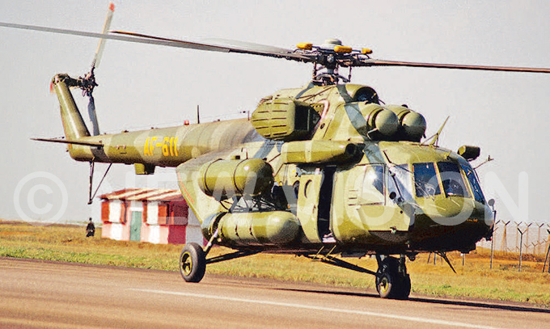
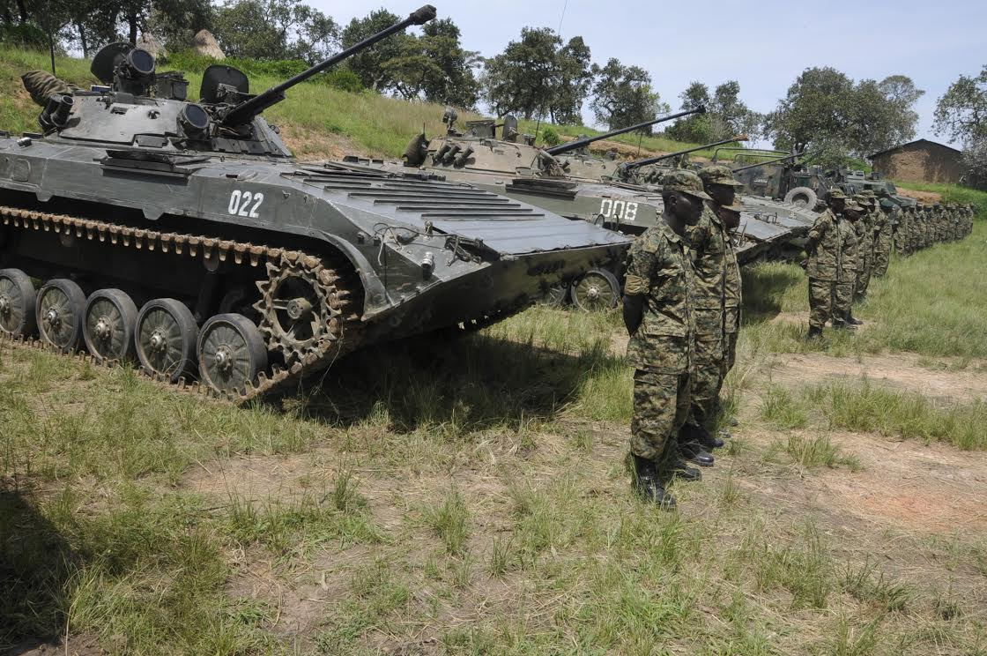
CAPABILITY

Slide 10
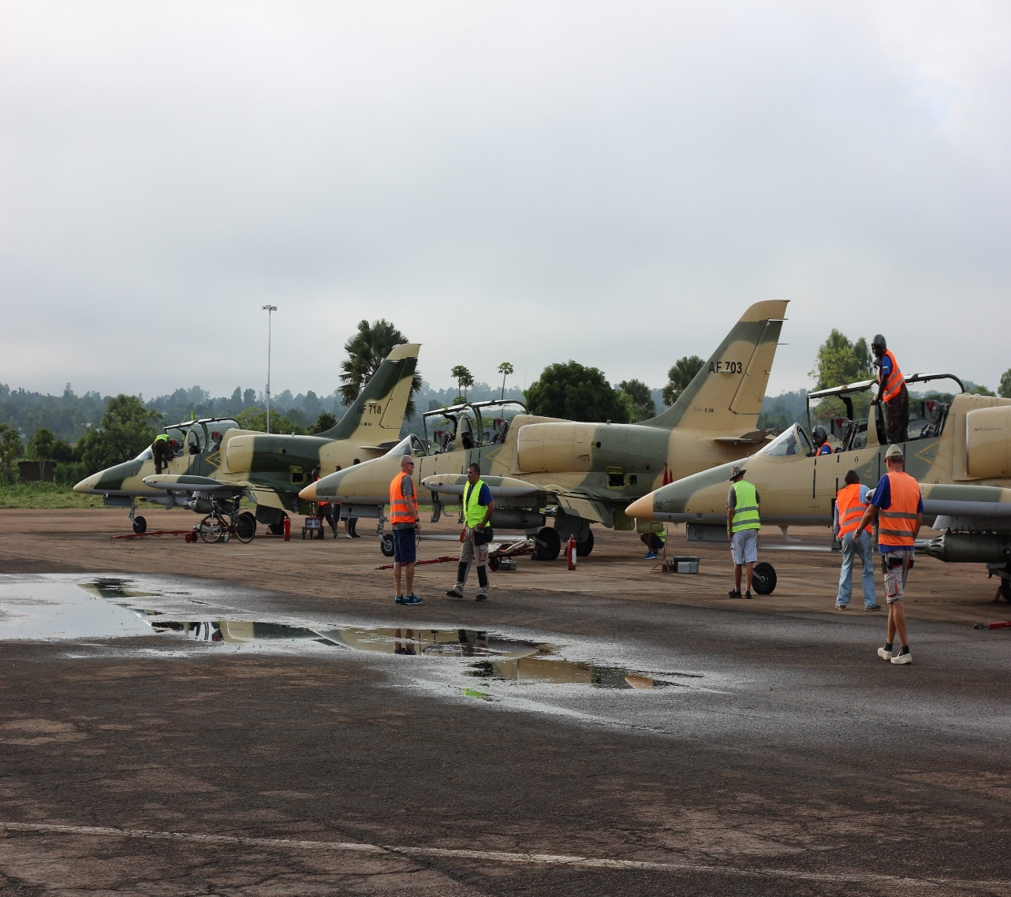
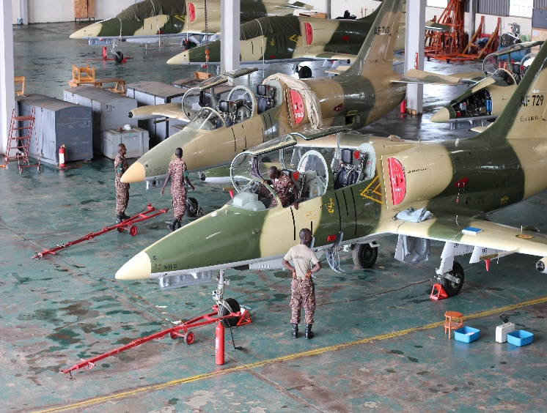
Capability

Slide 11
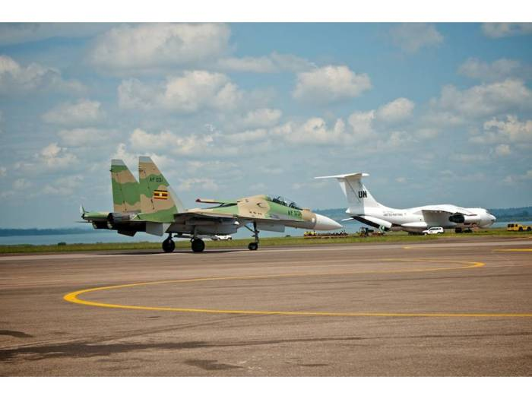
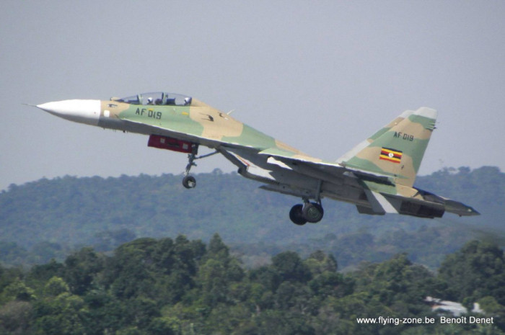
Capability

Slide 12
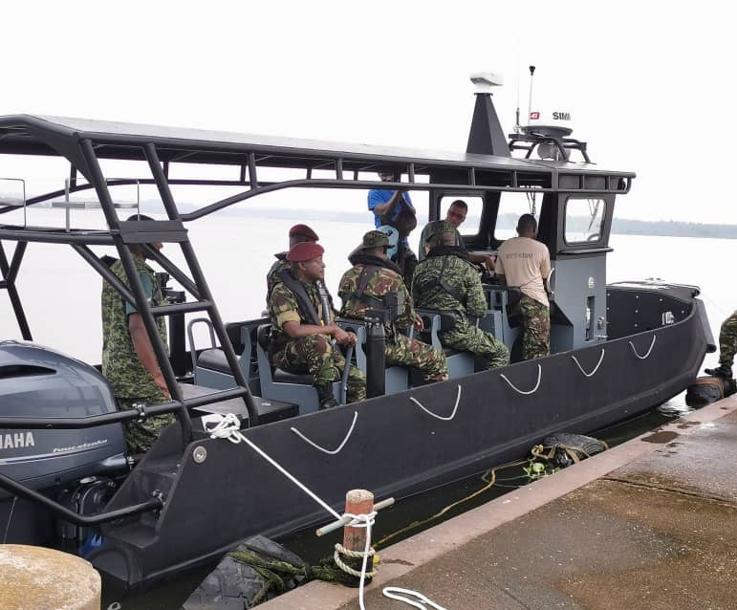
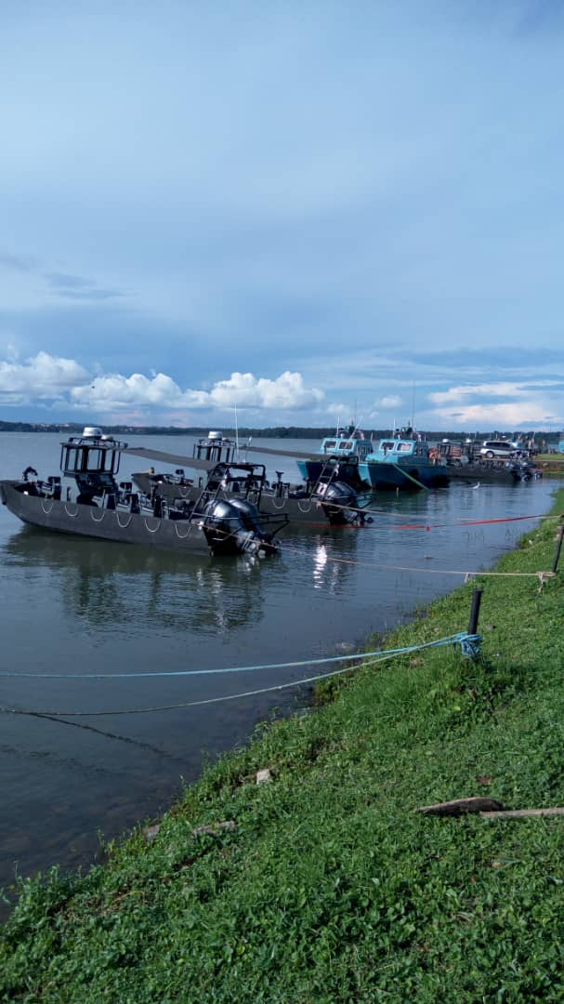
CAPABILITY

Slide 13
  Manifesto commitment and Presidential Directives achievements for the end-term (2016 – 2021)
S/No | Manifesto Commitment and Presidential Directive | Progress made
(a) | (b) | (c)
 | Manifesto Commitment: Continuing with Professionalization and Modernisation of the Defence and Security Forces. | Recruitment and Training: The Ministry annually recruited an average of 4,000 able-bodied Ugandans through the District Quota system to replenish the regular Force. Officers and Militants were annually trained and retrained locally and abroad for skills and knowledge acquisition to ably play their specific roles individually and collectively while executing defence missions. Major courses range from Basic to Leadership training. The Ministry has had targeted recruitments for Scientists to enhance the strength for doctors, pilots ,Engineers and Air Defence personnel. The Ministry also recruited and trained over 26,000 LDPs to complement the regular force in sustaining peace and stability in Kampala and across the Country. Courses for the award in Diploma, Bachelor’s and Master’s Degrees were undertaken in a bid to build capacity of Officers. SCSC-Kimaka, UMA – Kabamba and UMEC – Lugazi are affiliated and accredited to Makerere and Kyambogo Universities.

Slide 14
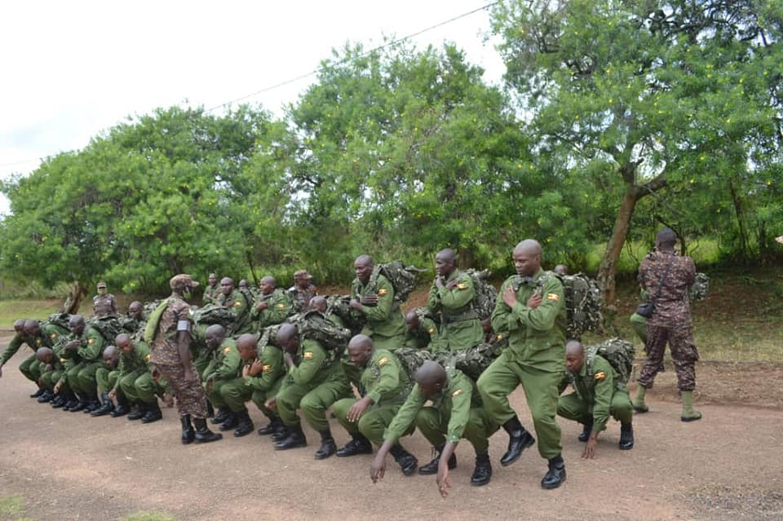
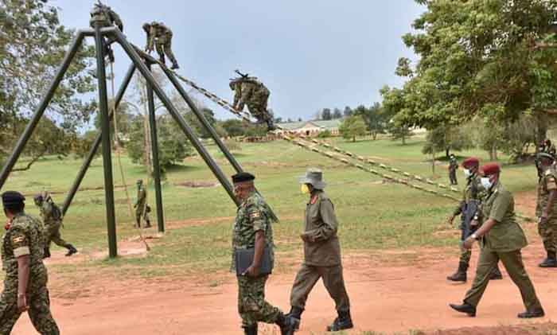
Training

Slide 15
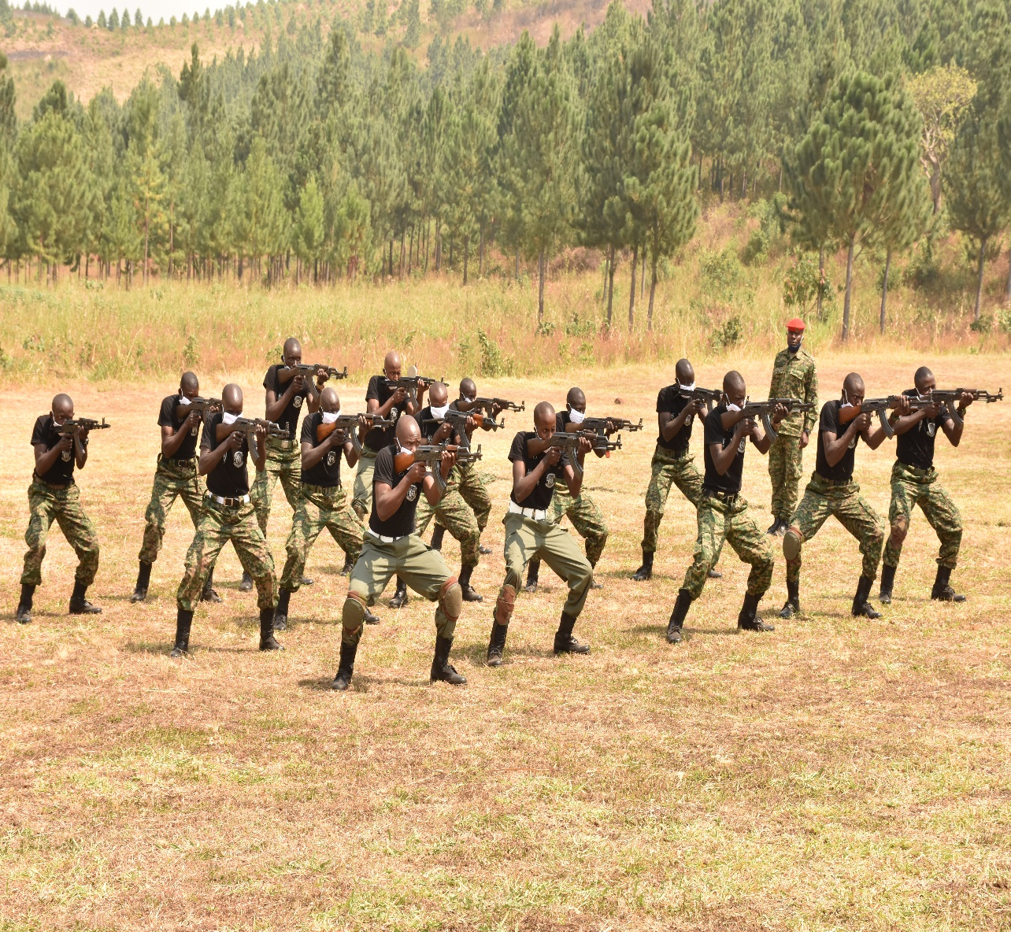
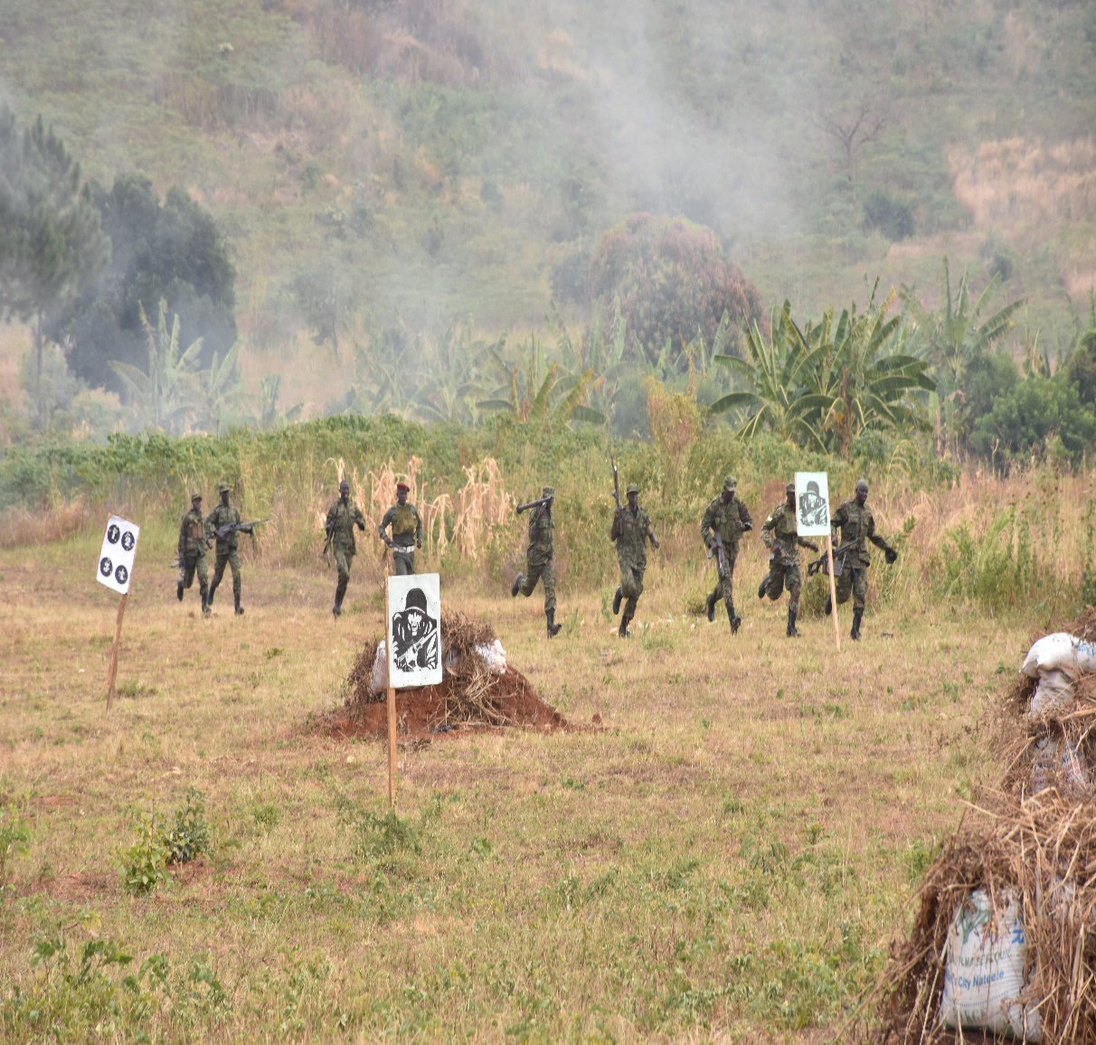
Training

Slide 16
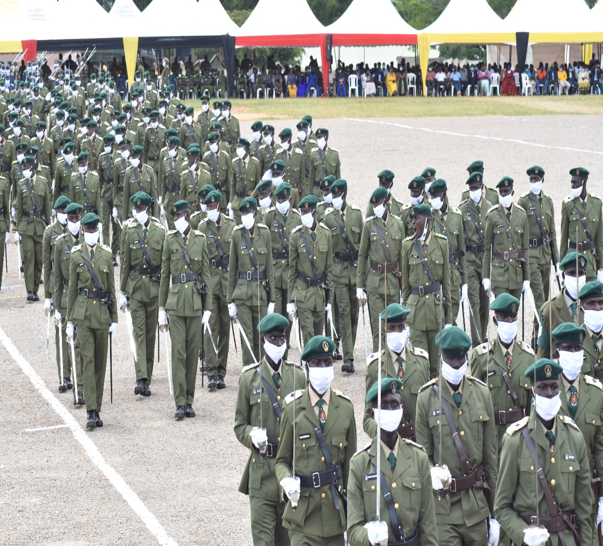
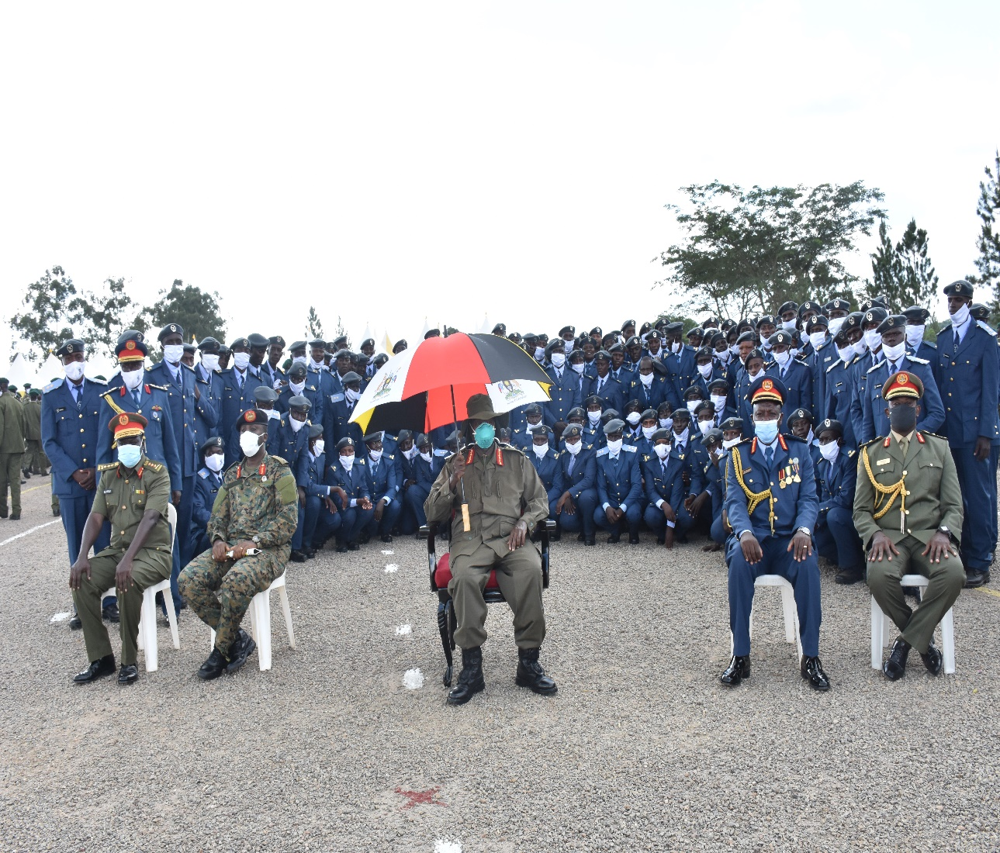
Pass out of Young Officers at UMA - Kabamba

Slide 17
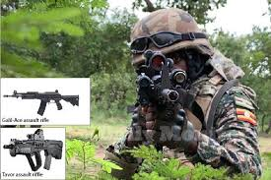
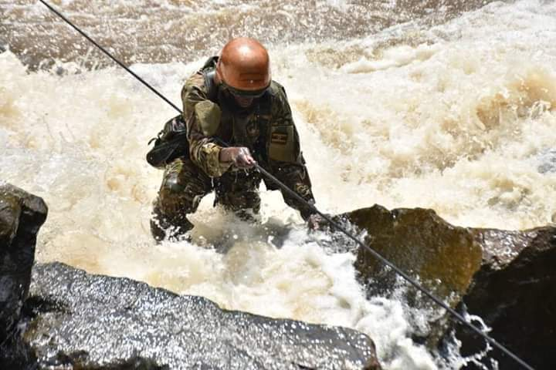
UPDF Commandos Training

Slide 18
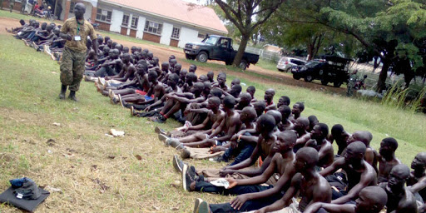
Recruitment at Kololo Air Strip

Slide 19
  Key Manifesto achievements for the end-term (2016 – 2021)
S/No | Manifesto Commitment and Presidential Directive | Progress made
(a) | (b ) | (c)
 | Manifesto Commitment: Continuing with Professionalization and Modernisation of the Defence and Security Forces. | c) Health care Services Preventive, curative and rehabilitative medical services were provided to Officers and Militants, their immediate families and surrounding community members in all MoDVA/UPDF 156 Health Centres. Medical Referrals were made for complex cases to other Health Facilities under MOU arrangements. Pharmaceutical drugs and sundries were also supplied and provided under an MOU arrangement with National Medical Stores (NMS) and Ministry of Health (MoH).

Slide 20
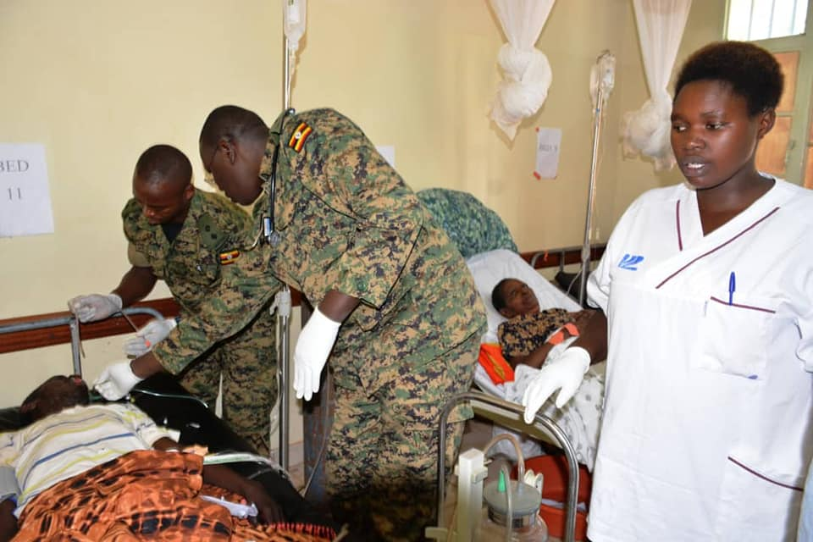
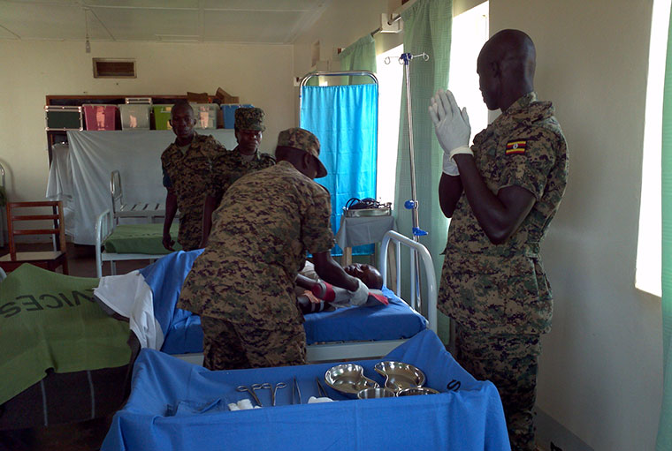
Medical Photos

Slide 21
  Key Manifesto achievements for the end-term (2016 – 2021)
S/N | Manifesto Commitment and Presidential Directive | Progress made
(a) | (b ) | (c)
 | Manifesto Commitment: Continuing with Professionalization and Modernisation of the Defence and Security Forces. | COVID - 19 The Ministry since the outbreak of COVID – 19 worked in collaboration with Ministry of Health (MOH) to prevent the spread of COVID-19 within the Country and along its boarders. The following measures were undertaken to address COVID – 19 and its challenges; a. Luweero Industries Limited (LIL) carried out a massive manufacturing and supply of sanitizers and masks. b. Trained health workers on Infection Prevention Control (IPC) measures as well as fumigating to disinfect UPDF barracks occasionally. c. Carried out supervision of implementation of Covid-19 SOPs at border points. d. Conducted food distribution exercise e. Continued rolling out COVID-19 vaccination exercise throughout all UPDF establishments

Slide 22
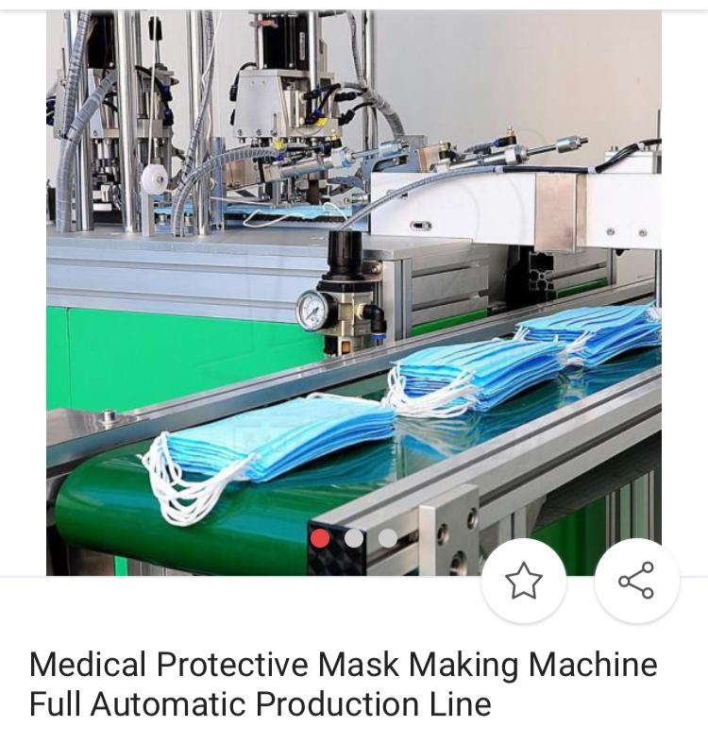
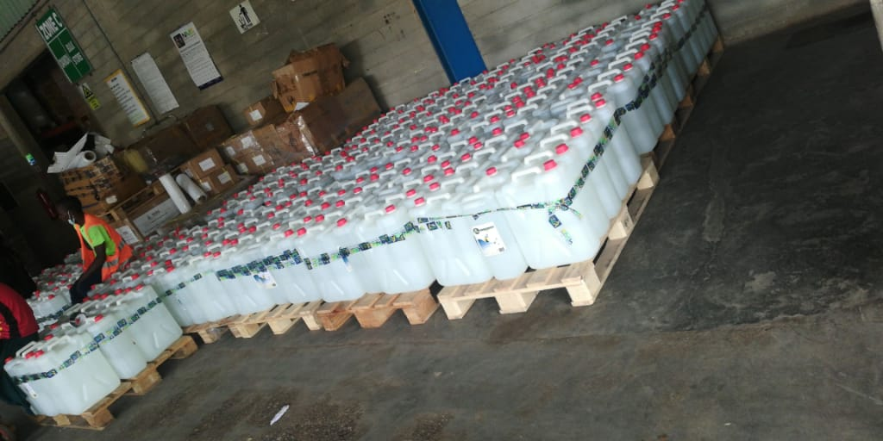
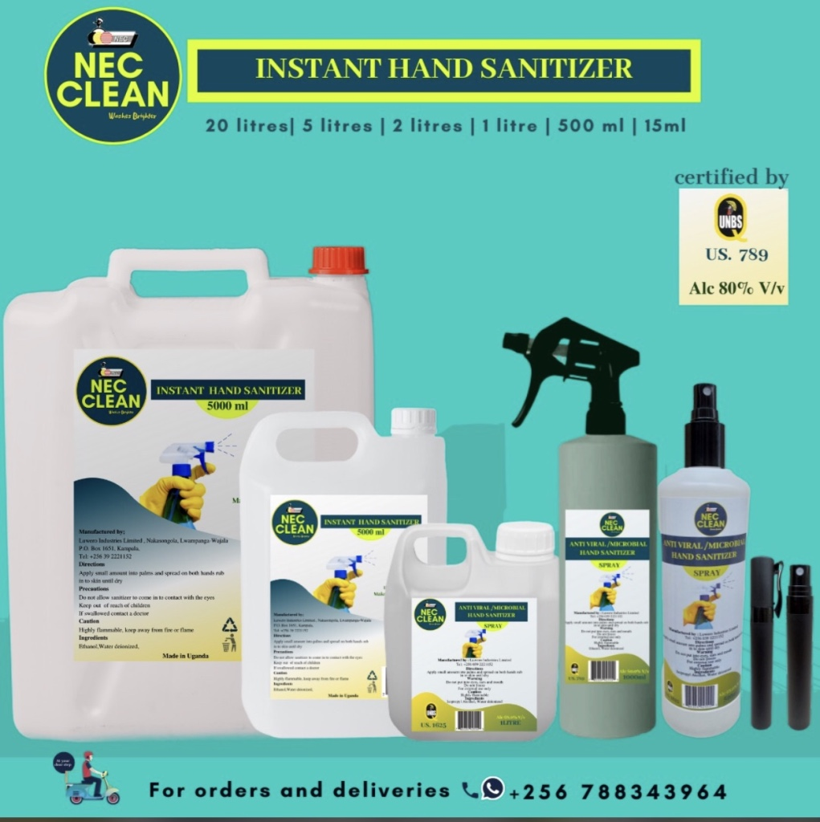
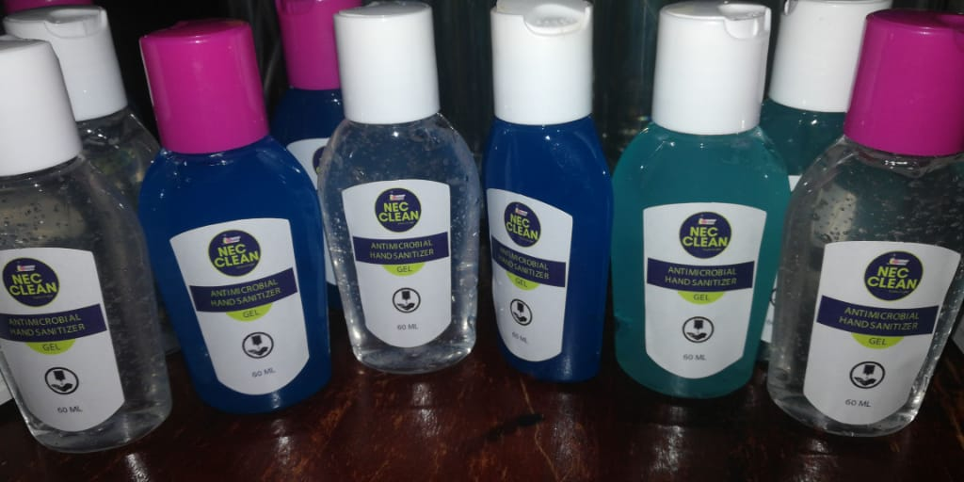
COVID-19 Prevention measures

Slide 23
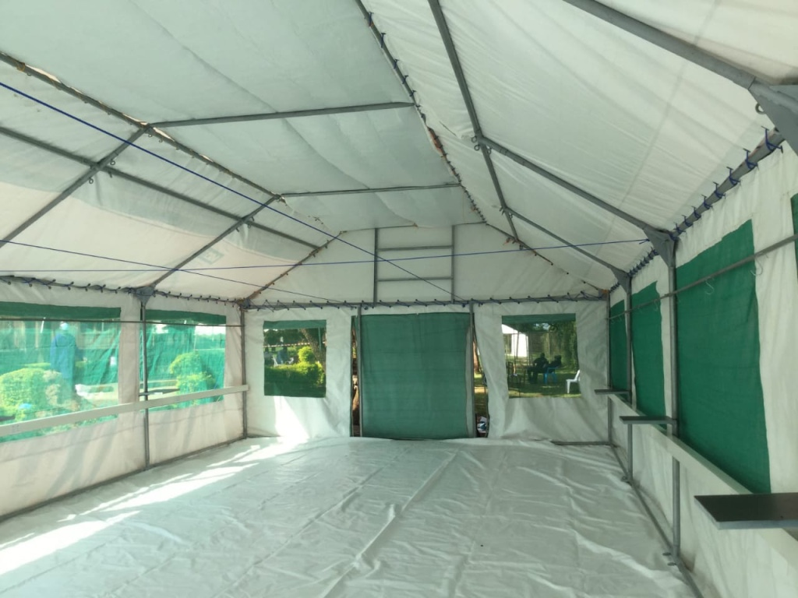
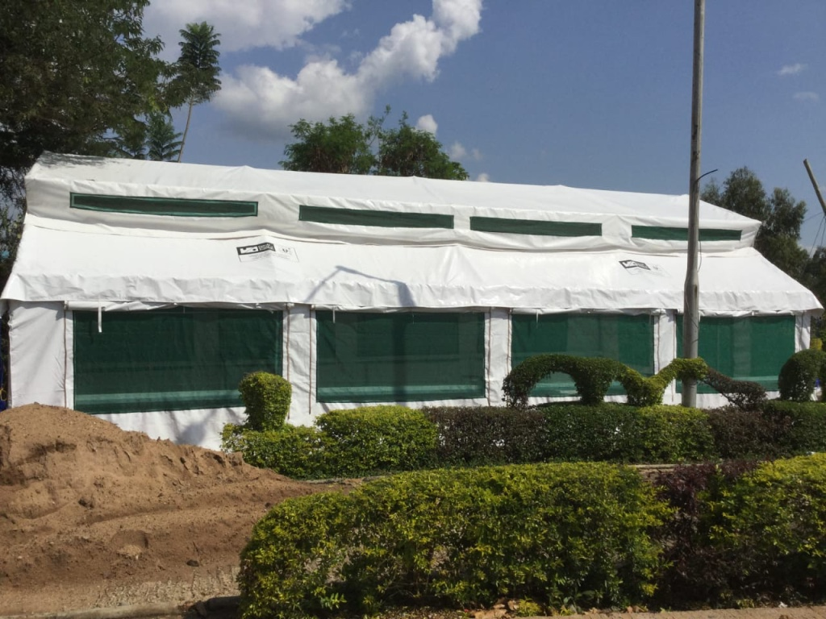
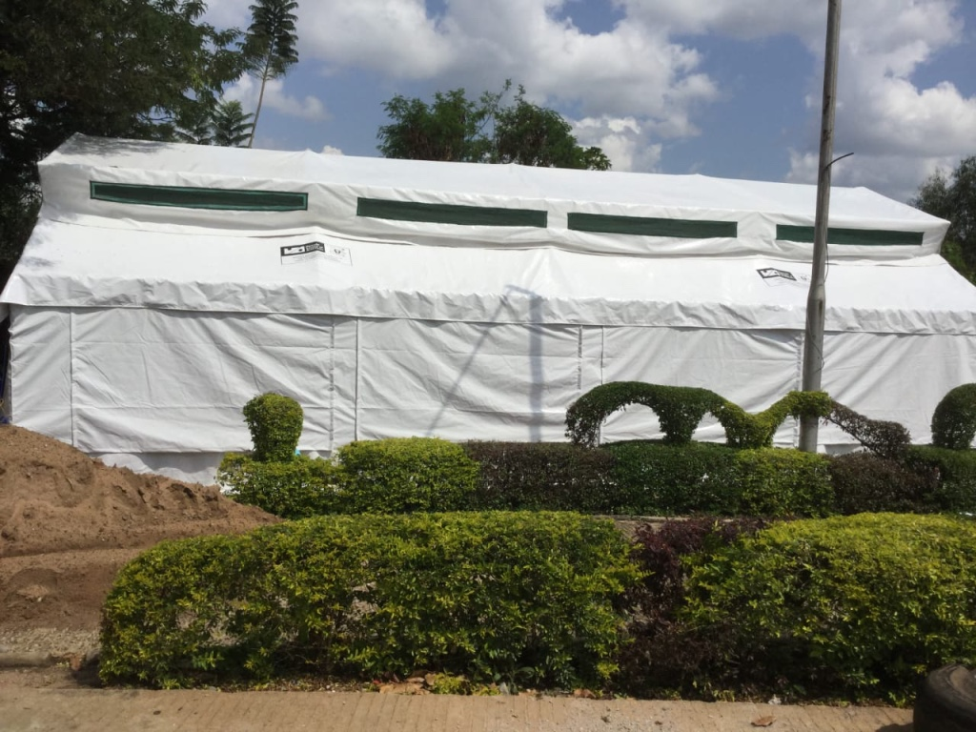
COVID-19 Prevention Measures
Working with Makerere University LIL fabricated 20 Epi-tent structures for medical tents used in various Stations .

Slide 24
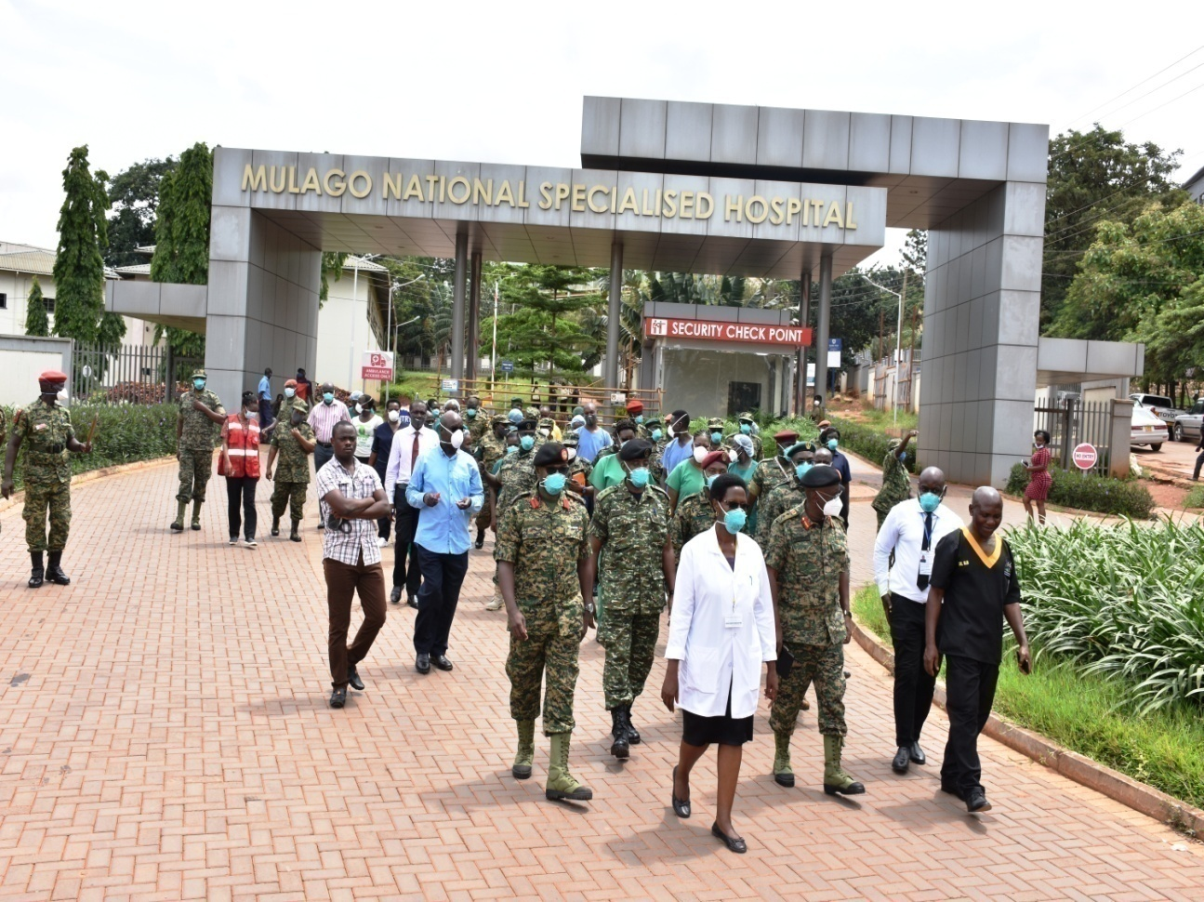
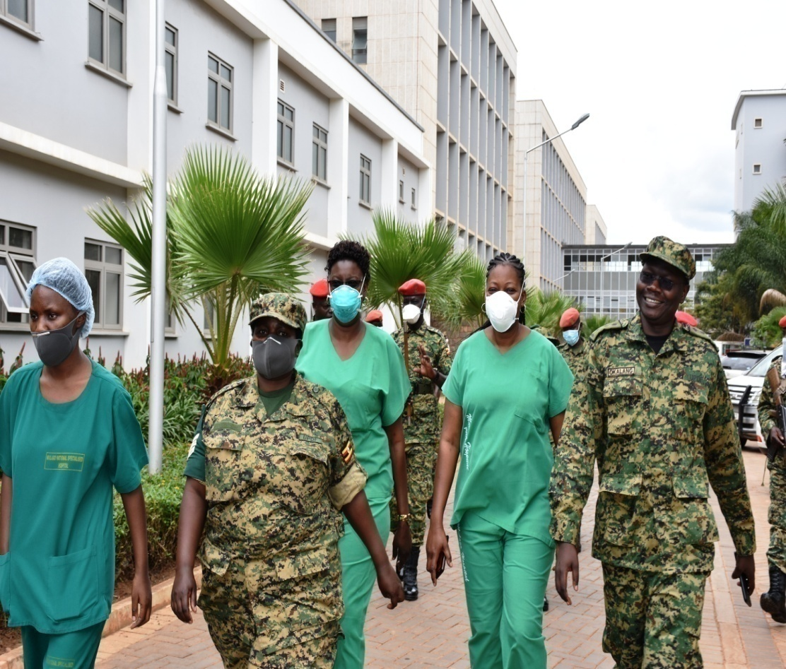
Medical Operation on COVID-19

Slide 25
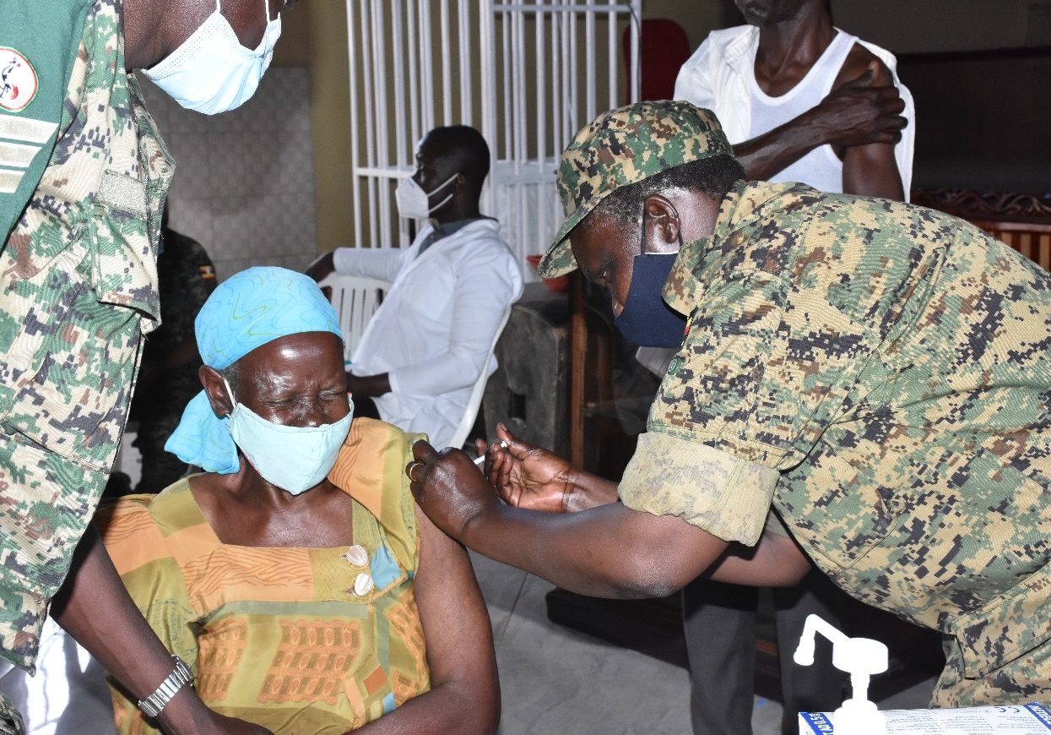
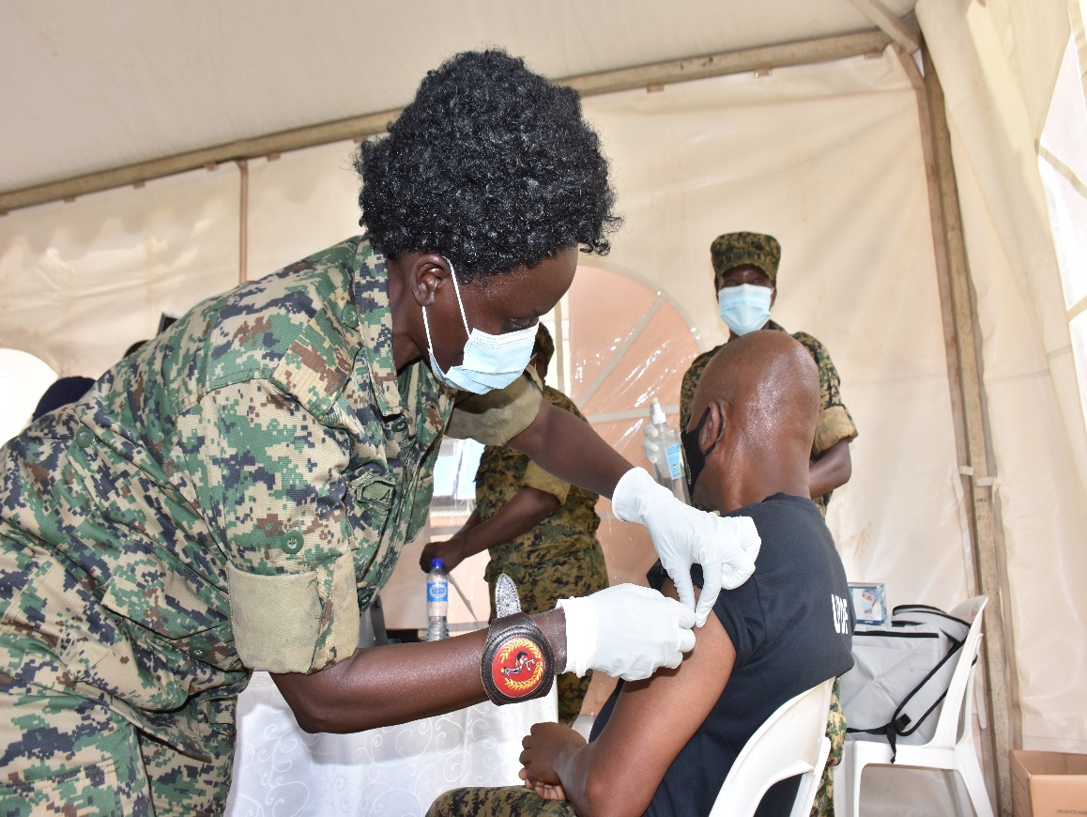
COVID – 19 VACCINATION

Slide 26
  Key Manifesto achievements for the end-term (2016 – 2021)
S/No | Manifesto Commitment and Presidential Directive | Progress made
(a) | (b ) | (c)
 | Presidential Directive: Construct National Military Referral Hospital (NMRH) in a phased manner. | Construction of a 250 Bed Military Referral Hospital at lower Mbuya. Civil works include: On-going works include OPD and special clinic, main pharmacy, laboratory, pediatric ward, emergency room, isolation and radiology wards, theatre, maternity and intensive care units. Currently civil works are over 70% completed. The Referral Hospital will also have Heart and Cancer Units. Other Health Facilities: Completed construction Works at lower Mbuya - Officers’ Diagnostic Centre with 02 Dental units and Outpatient Facility.

Slide 27
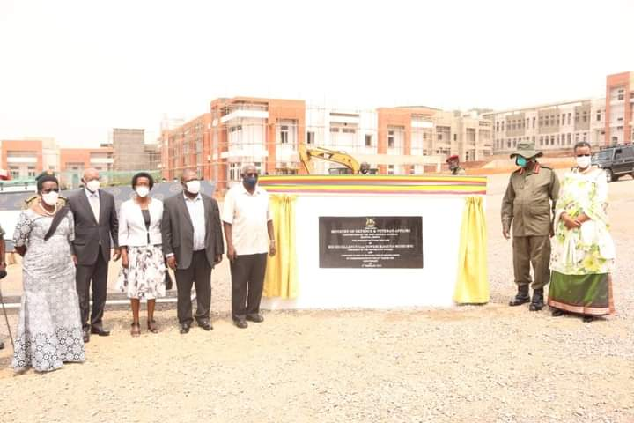
Military Referral Hospital (MRH)

Slide 28
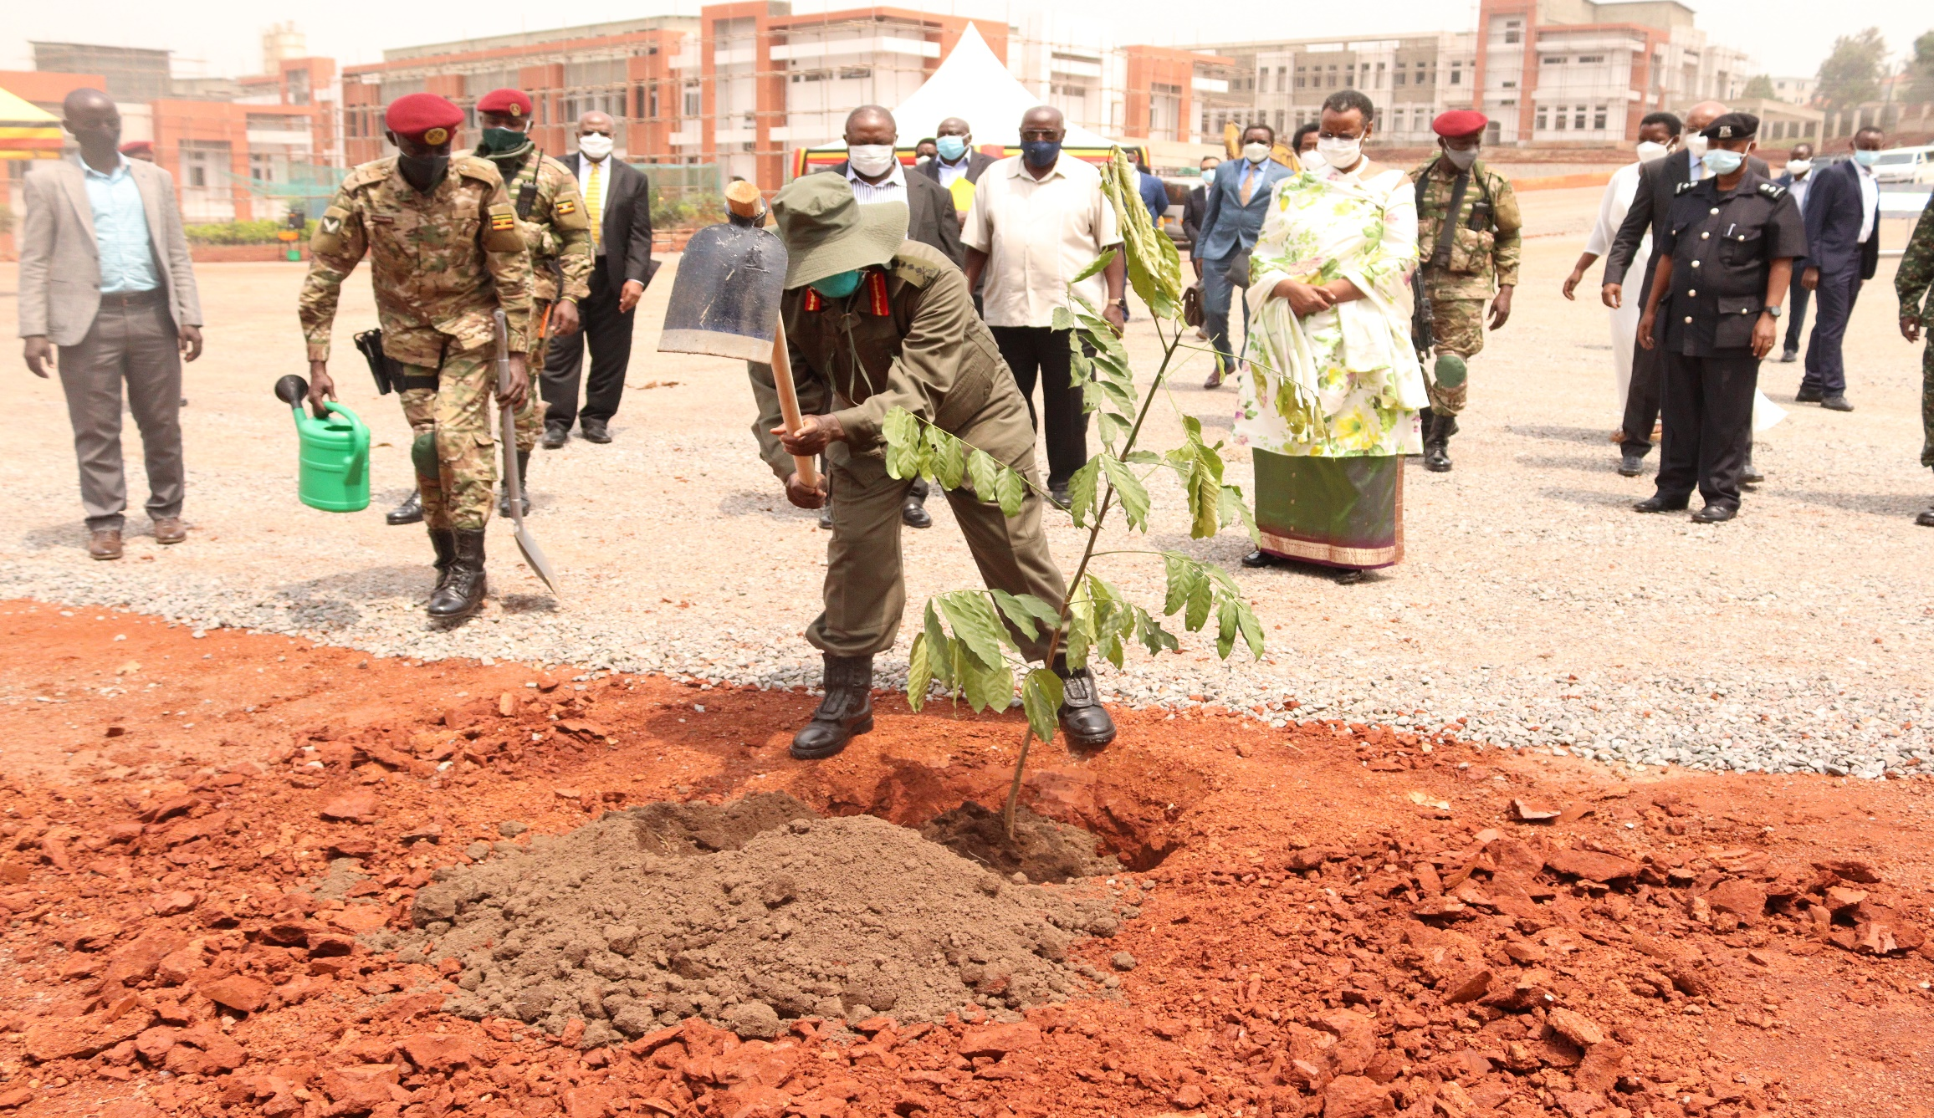
MRH Photos

Slide 29
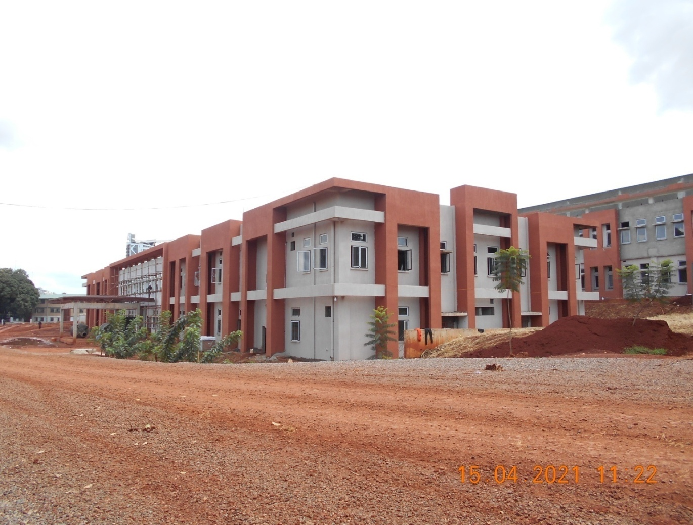
National Military Referral Hospital - Mbuya

Slide 30
  Manifesto Commitment and Presidential Directive Key achievements for the end-term (2016 – 2021)
S/No | Manifesto Commitment and Presidential Directive | Progress made
(a) | (b) | (c)
 | Welfare: Presidential Directive: Pay well scientists like engineers, pilots and doctors in order to retain them in UPDF and other establishments (e.g. LIL). Gradually and affordably increase the salaries of soldiers until they come in line with salaries of teachers and medical personnel. | For scientists, as a first phase, Doctors and other medical personnel salaries have been enhanced and other scientists will be enhanced later. Salary and wages: The salary increment has partially been realised among the lower ranks from Private to WO II. This was done in FY 2018/19 and no additions to the budget have been made since. Efforts have also been made with Ministry of Public Service (MoPS) to have the salary segmentation of UPDF Ranks.

Slide 31
  Key Manifesto achievements for the end-term (2016 – 2021)
Sn | Manifesto Commitment and Presidential Directive | Progress made
(a) | (b) | (c)
 | Presidential Directive: Organize Veterans to benefit from Operation Wealth creation and to engage in income generating activities as Government considers payment of the UGX 536bn Pension and Gratuity Arrears. | The Ministry had to first verify the backlog cases of over 79,000 case files worth Ushs 536bn. The Ministry has so far verified 25,033 backlog files worth Ushs 188,452,842,033. As of March, 2021, a total of 8,296 claimants had been paid Ushs 70,472,886,444. Verification and payment will continue to be done in the subsequent years. The Ministry has over the year engaged and supported Veterans in different income generating projects to improve their welfare. These Projects include, Apiary in Elgon (500 beehives) and Kabarole (200 beehives); and Fish Farming in Pallisa.

Slide 32
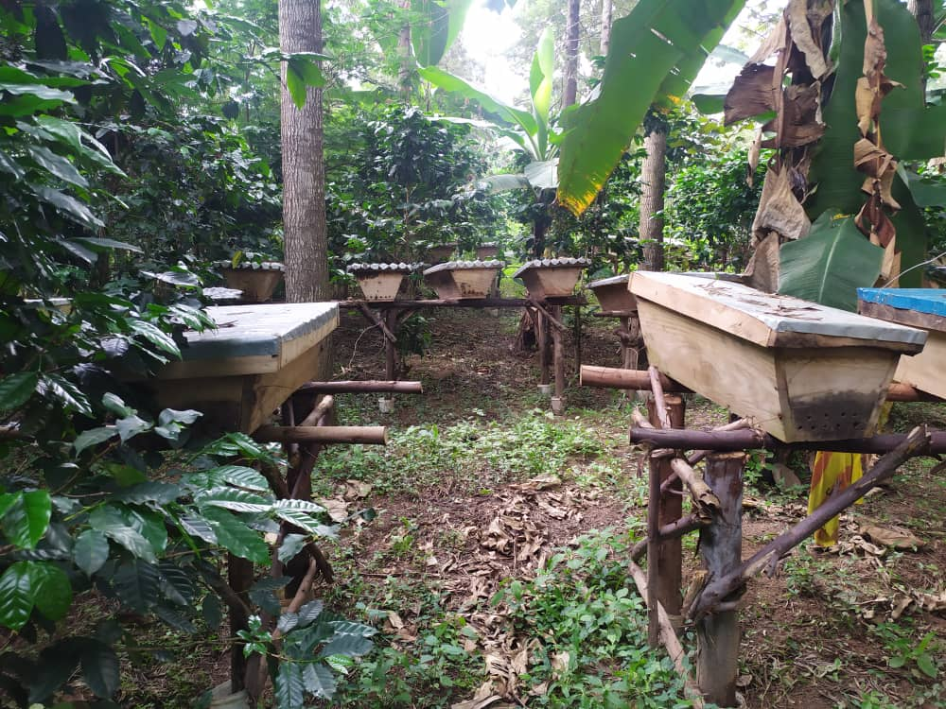
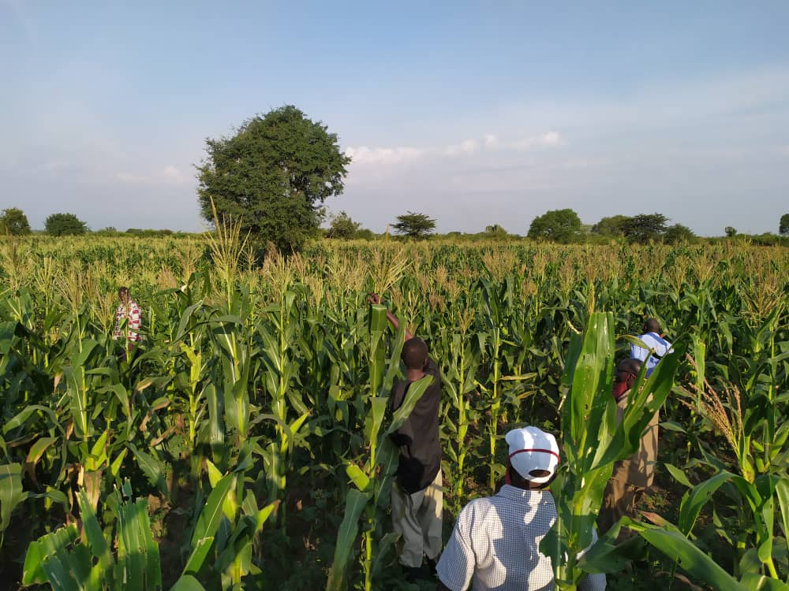
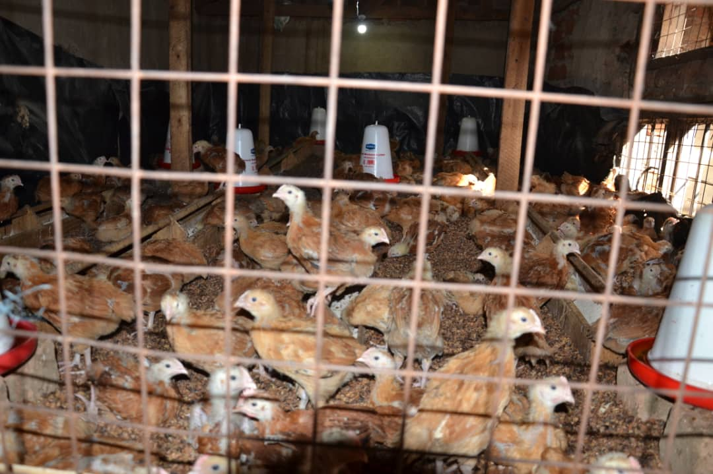
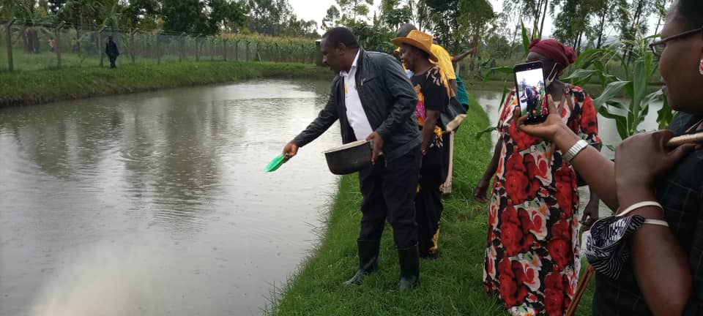
Income generating activities for Military veterans
Apiary project
Maize growing
Fish Farming
Poultry keeping

Slide 33
  Key Manifesto achievements for the end-term (2016 – 2021)
S/No | Manifesto Commitment and Presidential Directive | Progress made
(a) | (b) | (c)
 | Manifesto Commitment Developing Defence and Security Infrastructure: The NRM Government will continue with the construction of barracks to provide a conducive and habitable living environment for the personnel, as part of the welfare improvement program in the UPDF. Presidential Directive: Provision of Housing accommodation. | MoDVA finalized the UPDF Barracks Infrastructure Project of 30,000 Housing Units its bankable project and awaits funding by MoFPED. Completed construction of SFC administration block, 333, 303 and 501 Bde HQs administration blocks; 02 Div Strategic Defence Posture Infrastructure; Renovated 1, 2, 4 and 5 Division HQs Administration Blocks Constructed and/or renovated accommodation facilities at Sungura and Atto Hills, Service Brigade – Entebbe, Senior, Junior and NCOs housing units and storage facilities at PSO – TC Singo, water system, parade grounds, classroom and dormitories at RTS - Kaweweta; renovated housing units at Nsamizi, Air Force flats at Nakasongola and 04 Div HQs Gulu, dormitories at URDCC, bungalows at SCSC – Kimaka, renovated Kisangani housing units at 04 Div HQs Gulu and Senior and Junior staff quarters at 03 Div Moroto.

Slide 34
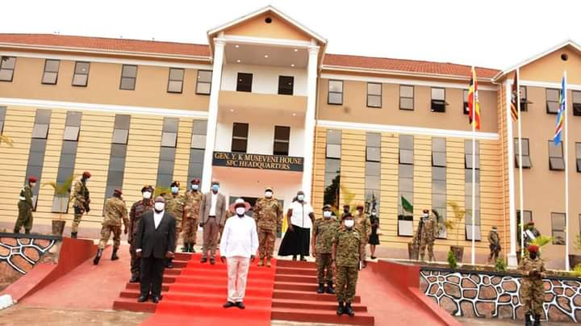
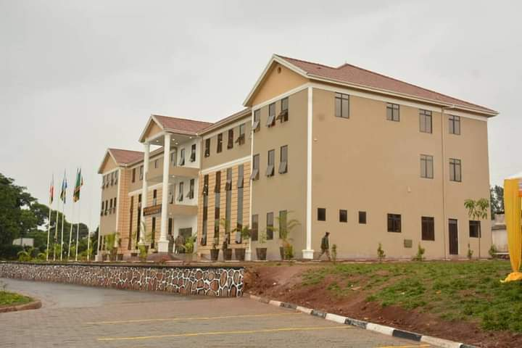
SFC HQs Administration Block

Slide 35
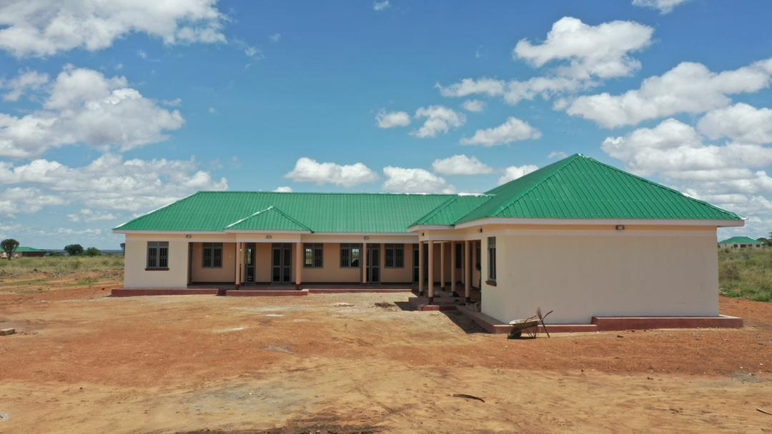
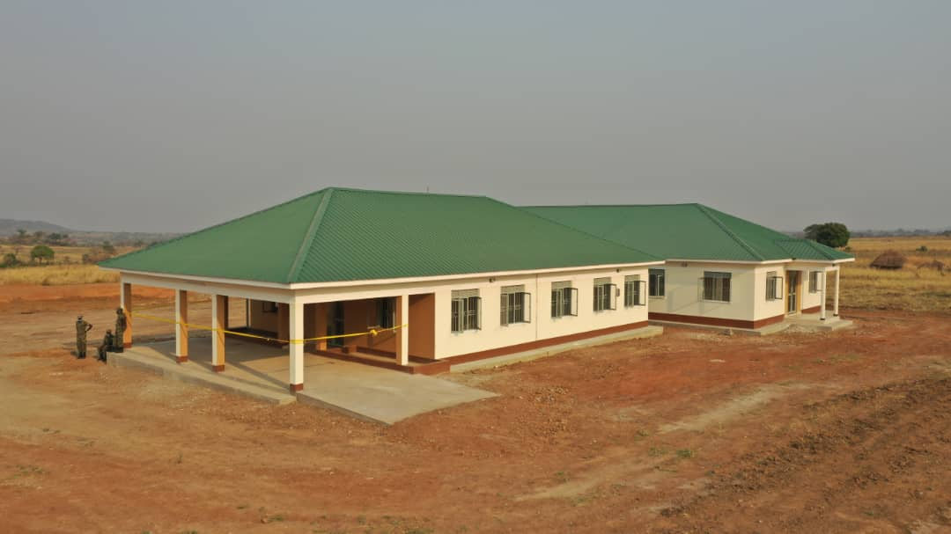
Office Blocks
Matany Bde-HQs
501 Bde HQs-Palaro

Slide 36
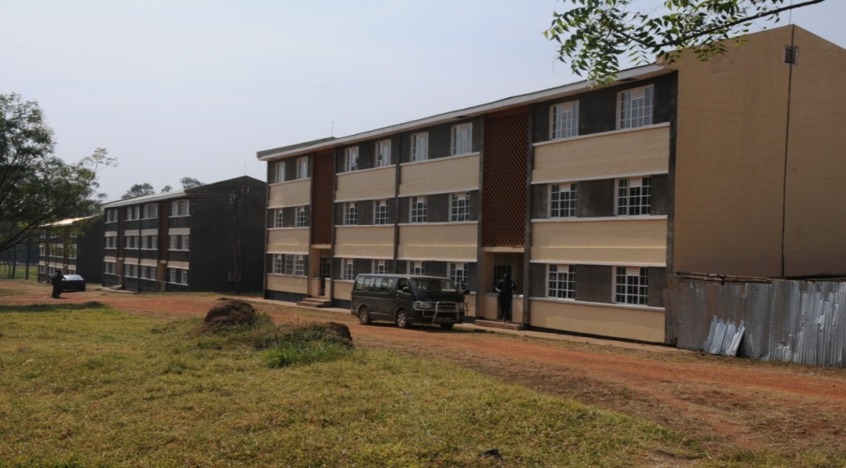
Infrastructure cont’d…….
Air Force Flats at 4Div HQs Gulu

Slide 37
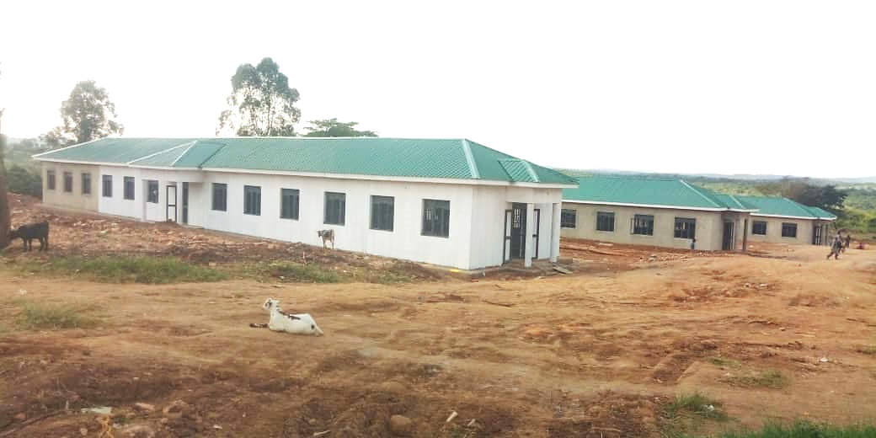
Housing Accommodation
Dormitories at Armoured Warfare Training School (AWTS)

Slide 38
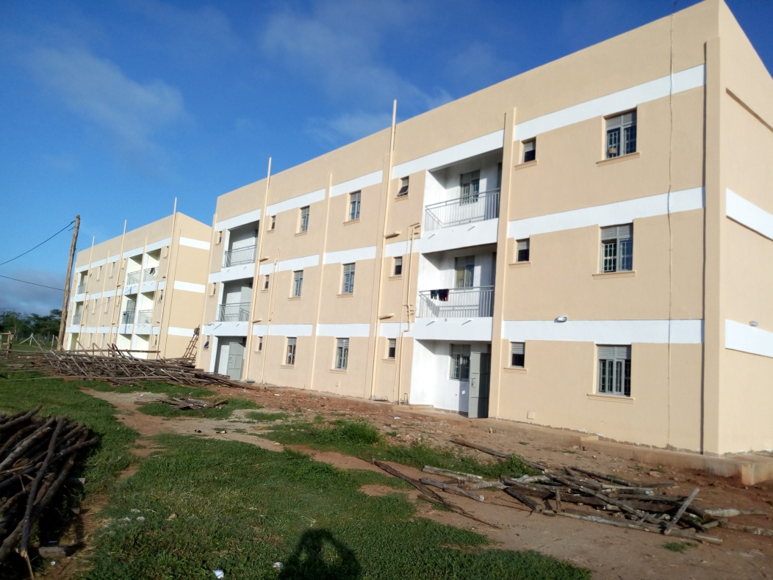
Housing Accommodation
Air Force Flats at Nakasongola

Slide 39
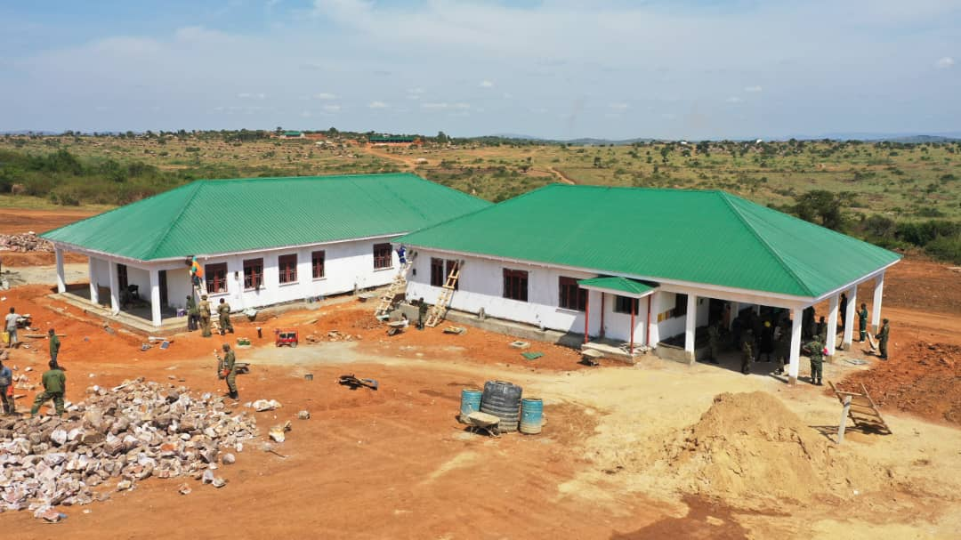
Health Facility
HC III at 2DIV

Slide 40


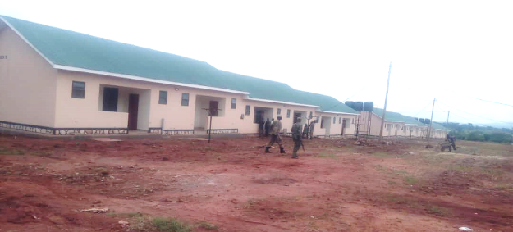
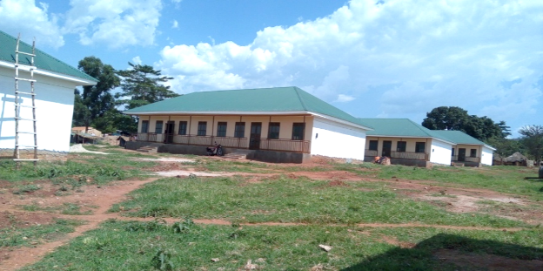
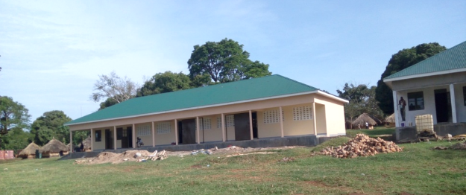
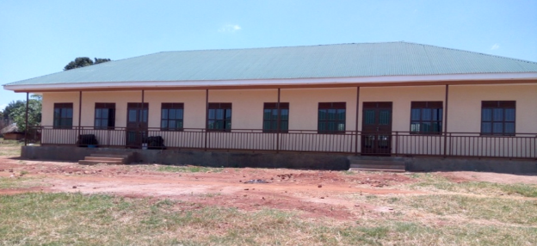
PSO- Training School
40
54 No Staff Houses
8 No dormitories
Armoury

Slide 41
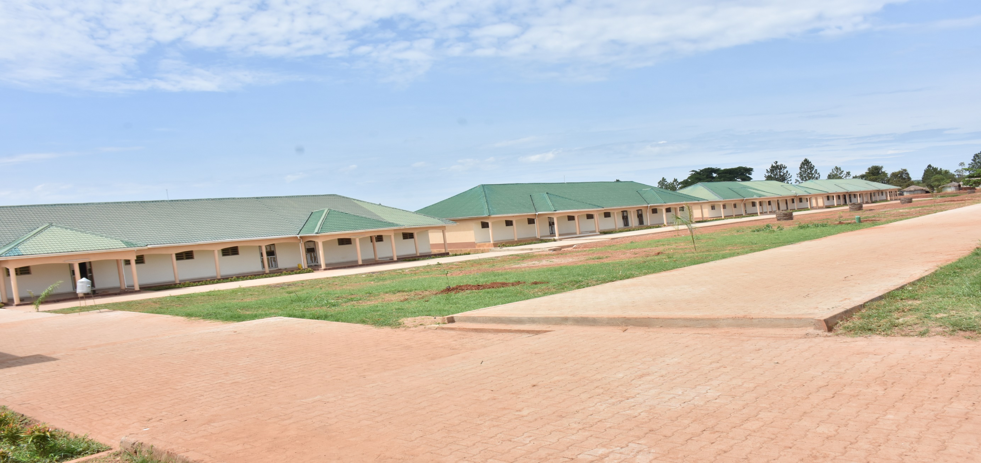
RTS – Kaweweta Photos – Class room block

Slide 42

RTS – Kaweweta - Dormitories

Slide 43

RTS – Kaweweta Parade Ground

Slide 44

RTS – Kaweweta Road Works

Slide 45

NALI Kyankwanzi VIP Wing

Slide 46

NALI – Kyankwanzi - Dormitories

Slide 47
  Key Manifesto achievements for the end-term (2016 – 2021)
S/No | Manifesto Commitment and Presidential Directive | Progress made
(a) | (b) | (c)
 | Presidential Directive: Moving the Air force from Entebbe to Nakasongola | MoDVA carried out the infrastructure developments at Nakasongola: Construction of new Hangar, ATC Tower, Taxiway, 02 blocks of flat consisting of 34 units, Accommodation, 02 air craft sheds, 02 simulator buildings, Runway, fire station, fencing among others. Some works are completed and others are on-going

Slide 48

Nakasongola Air Force Runway

Slide 49
  Key Manifesto achievements for the end-term (2016 – 2021)
S/No | Manifesto Commitment and Presidential Directive | Progress made
(a) | (b) | (c)
 | Presidential Directive: Expenditure on electricity, MoDVA should look at the option of running the barracks on solar power. | A 516 Kilo-Watts Kololo Solar pilot project was completed. The plans are underway to rollout the solar project in UPDF Barracks.
 | Presidential Directive: Expenditure on water; MoDVA should look at the option of drilling boreholes in the barracks and also install pumps so that water is pumped to a tank and it flows to users by gravity. | The Ministry has so far drilled 37 boreholes in different Barracks locations. This has reduced on expenditure of water in Barracks. Barracks with own water supply systems include, 01 Div-Kakiri, Ntungamo, Nakaperimor and Pajimu. Barracks with Surface water sources include RTS – Kaweweta, Hima, Mburaminzi, Bihanga, Butyaba, PSO – Singo and Kakyomya.

Slide 50


Kololo Solar Power Project
Layout of the Solar power panels at
Island Inventors (yellow)

Slide 51


Boreholes
Some of the drilled boreholes

Slide 52

RTS – Kaweweta Water

Slide 53
  Key Manifesto achievements for the end-term (2016 – 2021)
S/No | Manifesto Commitment and Presidential Directive | Progress made
 | Manifesto Commitment: Strengthening Research and Development. In order to keep pace with global trends in science, technology and innovation, the Defence Research, Science and Technology Centre (DRSTC) at Lugazi and the Avionics Research Centre at Nakasongola will be developed into centres of excellence for collaborative research with the private sector, universities and other agencies. | R&D was carried out through the five years in order to minimize dependence on foreign technologies and innovations, and at the same time to contribute to the Country’s technical and industrial development efforts. As such, MoDVA has invested in Defence Industries at Luwero Industries Limited (LIL) to boost its R&D capacity. MoDVA has collaborated with Makerere University and UIRI to ensure that this domain is improved within the Ministry’s operations. There are efforts to develop an R & D Policy to guide research and development.

Slide 54


Luwero Industries Ltd-R&D Products

Slide 55


Luwero Industries Ltd-R&D Products

Slide 56

LIL R&D Products

Slide 57
  Key Manifesto achievements for the end-term (2016 – 2021)
S/No | Manifesto Commitment and Presidential Directive | Progress made
(a) | (b) | (c)
 | Manifesto Commitment: Promoting production for wealth creation and self-sustainability. Defence and security will fully operationalise its mandate of contributing to national development. | MoDVA has two commercial production arms of NEC and UACC for economic development and transformation. The following have been achieved; Established NEC – Uzima Mineral Water which supplies mineral water on local market. A new production line was installed and will increase production from current 5,000 bottle per hour (bph) to 12,000 bph for the 500ml bottle in addition to 15,000 bph for the 330ml bottle and 6000bph for the 1.5 litre bottles. NEC carpentry workshop. In 2016, 2017 and other subsequent years, Junior Staff and Command College were supplied with furniture produced by NEC and furnished Kabamba Military Academy Auditorium. NEC – Construction Works engaged in the construction of the ICT Hub - Nakawa, the Sports Facility at Makerere University, Kiira Motors Production Plant. NEC – Katonga Farm has stocked currently over 500 High breed quality cows and a few Dairy cows. Further NEC completed and stocked Kyankwazi Farm with 450 bulls. NEC AGRO executed the distribution and Marketing of the Sukulu Fertilizers.

Slide 58




NEC UZIMA LTD
NEC UZIMA continues to supply mineral water to UPDF, State House; UPF during COVID ops and some Government agencies
LAUNCH OF UZIMA WATER,
by C-I-C

Slide 59


NEC – UZIMA MINERAL WATER
Aerial View of NEC - UZIMA
NEC – UZIMA New Production Line

Slide 60




NEC CARPENTRY
The factory has capacity to produce a range of hardwood, softwood and composite carpentry products..

Slide 61




Carpentry Products

Slide 62


NEC Kiira Motors Site
NEC Works

Slide 63


Joint Venture between NEC & Kiira Motors
Exterior Design
Interior Design

Slide 64


NEC – CONSTRUCTION WORKS
NEC Railway Works along Malaba -Busolwe
NEC Railway clearing along Tororo-Gulu

Slide 65

KYANKWANZI PROJECT (Cattle Dip)

Slide 66

KYANKWANZI PROJECT – Cattle Crash

Slide 67


NEC FARM KATONGA LTD

Slide 68




THE EGYPT-UGANDA INTEGRATED JOINT MODEL FARM AT KISOZI – NEC AGRO

Slide 69
  Key Manifesto achievements for the end-term (2016 – 2021)
S/No | Manifesto Commitment and Presidential Directive | Progress made
(a) | (b) | (c)
 | Manifesto Commitment: Promoting production for wealth creation and self-sustainability. Presidential Directive: Luweero industries should be given funds to buy the equipment needed to enable production of some of the supplies for UPDF. | There has been gradual increase in the capitalization of LIL to boost its production capacity for UPDF supplies and other markets. In recent years from FY 2016/17 to FY 2019/20, the budget allocation to LIL has gradually been increasing from Shs 2bn to Shs 10bn respectively. This has supported enhancing capacity of the Cartridge production and assembly, production of hardened tools, carbide dies and spares for domestic consumption and mounting and upgrade of Infantry Fighting Vehicles (IFVs), building the extensive metal fabrication plant, procured an CNC wood router for enhancing carpentry works (this improved production of furniture and a show room established at 7th Street Industrial Area).

Slide 70
  Key Manifesto achievements (2016 – 2021)
S/No | Manifesto Commitment and Presidential Directive | Progress made
(a) | (b) | (c)
 | Manifesto Commitment: Promoting production for wealth creation and self-sustainability. Presidential Directive: Funding Uganda Air Cargo Co. Ltd (UACC). This should be taken as a strategic item. We are discussing the revival of Uganda Airlines; we also need an air cargo that will help our horticulture exporters to transport their goods to various destinations. MoFPED should address the matter. | Shs 46bn was allocated to the entity in FY 2020/21 to boost the functioning of UACC. This enabled UACC to revive the following key operational licenses including; Air Operator Certificate (AOC), Air Service Licence (ASL), Approved Maintenance Organisation (AMO), Certificate of Assurance (CoA). The 5x – UCF C130 ( Silver Lady) is operational The 5X-UDF C130 is grounded but the Maintenance & Repair Organization (MRO) is on going The two cargo crafts will conduct operations in UN and AU; and transport Ugandan exports and imports.

Slide 71
Silver Lady C - 130
Aircraft Registration mark 5X-UCF

Slide 72
  Key Manifesto achievements for 2016 – 2021
S/No | Manifesto Commitment and Presidential Directive | Progress made
(a) | (b) | (c)
 | Manifesto Commitment: Strengthening Internal and External Security | Internal: The Ministry extended support of the Uganda Police Force (UPF) and other security organisations to ensure a peaceful and stable Country towards and after the conduct of the recently concluded General Elections at Presidential, Parliamentary and Local Government levels in January 2021. A total of 82 rifles and 13,987 heads of cattle were recovered from rustlers since July, 2020. Incursions from armed pastoral groups from Kenya and South Sudan in the districts of Kaabong, Kotida and Napak were neutralized. Incidences of intermittent livestock thefts and general criminality remain a concern and the UPDF has increased the scale of operations to deal with the practice. The Local Defence Personnel (LDPs) were also recruited to augment the strength of UPDF, UPF and other security agencies to curtail prevailing and emerging security threats and also impose the Standard Operating Procedures (SOPs) of COVID-19 in especially the Kampala Metropolitan Area (KMA) and surrounding districts.

Slide 73
  Key Manifesto achievements for the end-term (2016 – 2021)
S/No | Manifesto Commitment and Presidential Directive | Progress made
(a) | (b) | (c)
 | Manifesto Commitment: Strengthening Internal and External Security | External: To date the UPDF has deployed 32 Uganda Battle Groups (UGA BAG XXXII) to further consolidate support to the Federal Government’s effective functionality. These efforts have significantly contributed to further degrading the Al-Shabaab and as a result peace and security has continued to prevail in most parts of Somalia. UPDF has also deployed in Equatorial Guinea under the Uganda Military Training and Mentoring Team (UMTMT)

Slide 74


AMISOM OPERATION

Slide 75


AMISOM OPERATION

Slide 76
  Key Manifesto achievements for the end-term (2016 – 2021)
S/No | Manifesto Commitment and Presidential Directive | Progress made
(a) | (b) | (c)
 | Presidential Directive: Create income generating projects for soldiers’ spouses | Agricultural support supervision – UPDF spouses were trained in proper management of crops and animals in various Formations and Units including SOFAAD, Olilim-Training School, Lugore Training Schools, Nakasongola Cantonment, FAD- Masindi, UMAK, Hima TS and Bihanga Training Schools. Animal Husbandry – Supported spouses in establishing incoming generating projects like piggery, poultry and goat rearing. Skills development training - Ministry trained over 70 women on crafts and tailoring projects at Lower Mbuya. Presidential Support Fund. The Ministry allocated a Presidential Support Fund worth Shs 1.9bn to women groups in barracks as a Revolving Loan Fund (RLF). As a result, 27 UPDF Units were visited and 1,863 people benefited. Village Savings and Loans Associations (VSLA): Currently there are 81 Village Savings and Loan Association groups with over 3,429 members.

Slide 77
Other Achievements in Civil Military Operations
One of UPDF’s functions is to cooperate with civil authority in emergency situations and in cases of natural disasters. Over the years, UPDF has been involved in a number of such emergency situations. Some of which include;
  Conducted constructions of schools and health centres in the Tarehe – Sita celebrations
  Rescuing affected people from landslides
  Rescuing citizens in areas affected by floods
  Fight against the outbreak of Locusts in the North Eastern Uganda (Karamoja areas) and some parts of Eastern Uganda in the Soroti Region.
  Support other Agencies in the fight against Ebola and COVID Pandemics.
  Treating civilian patients in different Government Hospitals
  Supported UNRA and MoWT to shred a floating vegetation at Jinja Dam.

Slide 78


Tarehe-Sita Projects
Kabonera Health Centre II
Kiti Core Primary School - Kalungu

Slide 79


Tarehe-Sita Projects
Treating Patients at HC III - Bukomasimbi
Renovating HC III - Kalungu

Slide 80


UPDF Soldiers during fight against Locusts

Slide 81


UPDF supporting UNRA and MoWT to clear floating vegetation at Jinja Dam

Slide 82
  Targets that were not met and why
SN | Un-fulfilled Targets | Reasons for Non-fulfillment
01 | Introduce the national service system to inculcate patriotism and ensure early positive nurturing and mentoring towards hard work and vocational skills
 | Introduction of a National Service Scheme | Objective 1(5) of NDPIII on Governance and Security interventions and respective actors mandates MODVA to establish and operationalise a National Service Programme. The Ministry undertook benchmarking exercise and a Cabinet information paper was produced
 | Gradually and affordably increase the salaries of soldiers until they come in line with the salaries of teachers and medical personnel. Pay well scientists – engineers, pilots and doctors in order to retain them in UPDF and other establishments (e.g. LIL). | Salaries for soldiers have been gradually increasing. In FY 2018/19, partial salary enhancement for lower ranks was done where a Private’s salary was enhanced from shs 385,000 to shs 485,000. However this needs to be enhanced further. The enhancement still remains to be done across board from lower rank to General. In regard to payment of scientists, the Ministry has achieved in paying all medical personnel. However, due to inadequate funding, other category of scientists are yet to be addressed.

Slide 83
  Targets that were not met and why
SN | Un-fulfilled Targets | Reasons for Non-fulfillment
3 | Continuing with Professionalisation and modernisation
 | Establishment of the National Defence College (NDC) | The processes are on ongoing for acquisition of Land and Infrastructure at Njeru, Jinja. Currently, the leadership of the College has been appointed and the first course at NDC will commence in FY 2021/22.
 | Developing defence and security infrastructure
 | Continue with construction and rehabilitation of the Barracks Infrastructure. | The Ministry earmarked construction of barracks as a priority area. To address this, a project for 30,000 housing units was developed and requires Ushs 3.7trn to be implemented. MoFPED guided that this project is handled using the Development Committee Guidelines. Following those guidelines, a Concept, Profile, Pre-feasibility and Feasibility studies were developed by MoDVA and approved by MoFPED as Bankable Project. However, funds have not yet been availed to kick-start this project.

Slide 84
CHALLENGES FACED DURING IMPLEMENTATION OF THE MANIFESTO COMMITMENTS
Limited Budget: The budgetary allocations to the Ministry were not sufficient enough to boost the Ministry’s ability to fully implement most commitments. This heavily affected the 30,000 Housing Project and the production capacity and potential of the Ministry to engage in production activities for socio-economic transformation.
Ever changing Technology: Improving the capacity and capability of the Force has not been fully achieved to match the ever changing technologies.
COVID-19 Pandemic: In the period review, the ministry had to reprioritize and redirect its resources including personnel from the core Defence activities to curtail the spread of the COVID-19 pandemic.

Slide 85
Way Forward
The Ministry has amidst challenges been able to achieve on its Constitutional mandate of defending and protecting the people and their property. The peace and stability experienced in the previous five years has been a manifest of resilience and commitment by the People of Uganda and UPDF. Overall the Ministry performed at 96%.
UPDF pledges to continue upholding its mandate and fulfill the Manifesto Commitments that were not implemented in 2016-2021. MODVA will further implement commitments recently pronounced in the Manifesto of 2021 – 2026.
Furthermore, continuous engagements with MOFPED will be done to ensure funding is sought towards improvement of soldier’s welfare e.g. salary enhancement, construction of housing accommodation among others.

Slide 86
Thank you for listening

